Slide 1
Design Patterns
https://martinfowler.com/design.html
Notes:
Design patterns gained popularity in computer science after the book Design Patterns: Elements of Reusable Object-Oriented Software was published in 1994 by the so-called "Gang of Four”
Design patterns were originally grouped into the categories: creational patterns, structural patterns, and behavioral patterns, and described using the concepts of delegation, aggregation, and consultation. Another classification has also introduced the notion of architectural design pattern that may be applied at the architecture level of the software such as the Model-View-Controller pattern. The following patterns are taken from Design Patterns ^{[3]} and Code Complete,^{[6]} unless otherwise stated.

Slide 2
Introduction
Design patterns are solutions to recurring problems; guidelines on how to tackle certain problems. They are not classes, packages or libraries that you can plug into your application and wait for the magic to happen. These are, rather, guidelines on how to tackle certain problems in certain situations.
Notes:
In software engineering, a software design pattern is a general reusable solution to a commonly occurring problem within a given context in software design. It is not a finished design that can be transformed directly into source or machine code. It is a description or template for how to solve a problem that can be used in many different situations.
Design patterns are not a silver bullet to all your problems.
Do not try to force them; bad things are supposed to happen, if done so. Keep in mind that design patterns are solutions to problems, not solutions finding problems; so don't overthink.
If used in a correct place in a correct manner, they can prove to be a savior; or else they can result in a horrible mess of a code.

Slide 3
Type of Design Patterns
Creational
Creational patterns are focused towards how to instantiate an object or group of related objects.
Structural
Structural patterns are mostly concerned with object composition or in other words how the entities can use each other. Or yet another explanation would be, they help in answering "How to build a software component?"
Behavioral
It is concerned with assignment of responsibilities between the objects. What makes them different from structural patterns is they don't just specify the structure but also outline the patterns for message passing/communication between them. Or in other words, they assist in answering "How to run a behavior in software component?"

Slide 4
Creational
In software engineering, creational design patterns are design patterns that deal with object creation mechanisms, trying to create objects in a manner suitable to the situation. The basic form of object creation could result in design problems or added complexity to the design. Creational design patterns solve this problem by somehow controlling this object creation.
Notes:
Creational patterns are focused towards how to instantiate an object or group of related objects.

Slide 5
Simple Factory
Real world example
Consider, you are building a house and you need doors. It would be a mess if every time you need a door, you put on your carpenter clothes and start making a door in your house. Instead you get it made from a factory.
In plain words
Simple factory simply generates an instance for client without exposing any instantiation logic to the client
Wikipedia says
In object-oriented programming (OOP), a factory is an object for creating other objects – formally a factory is a function or method that returns objects of a varying prototype or class from some method call, which is assumed to be "new".

Slide 6
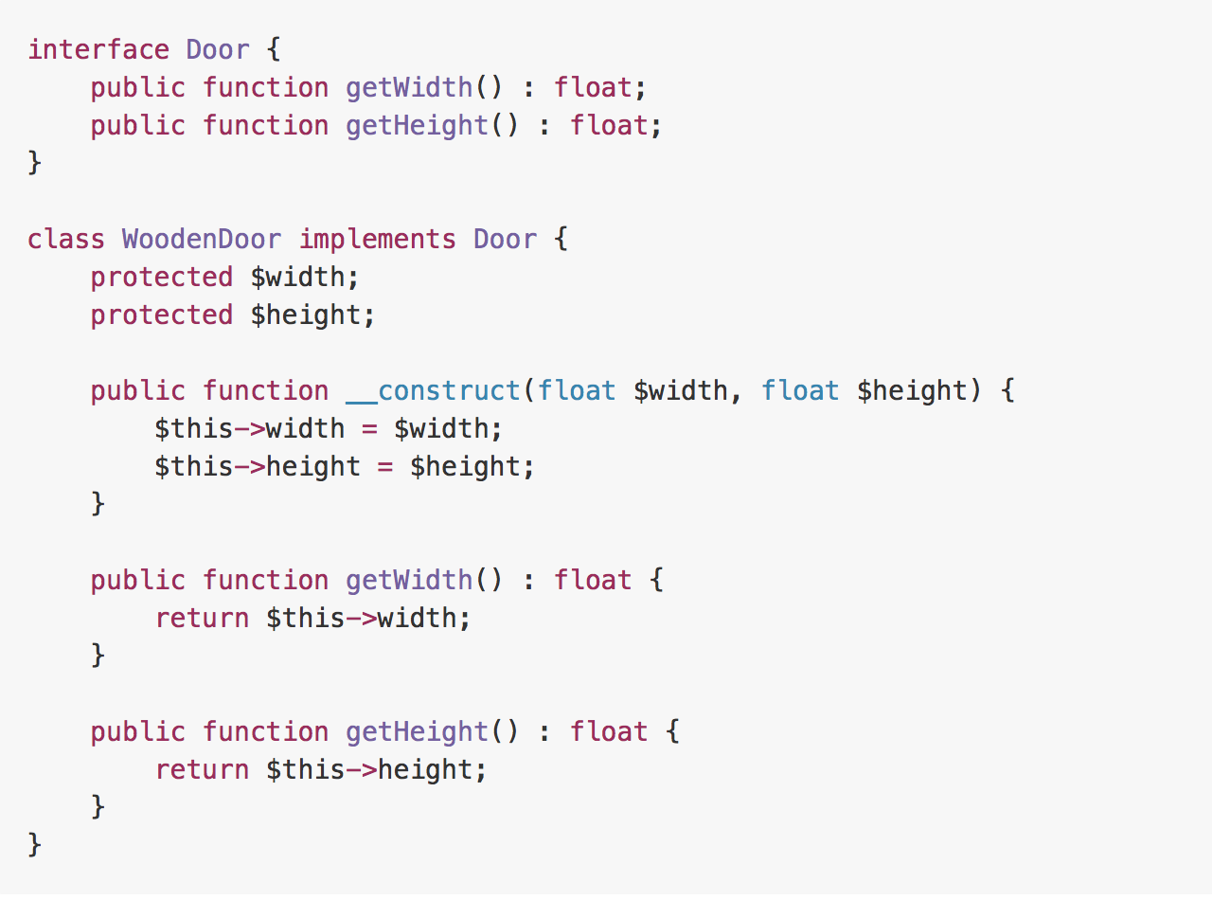
Example

Slide 7
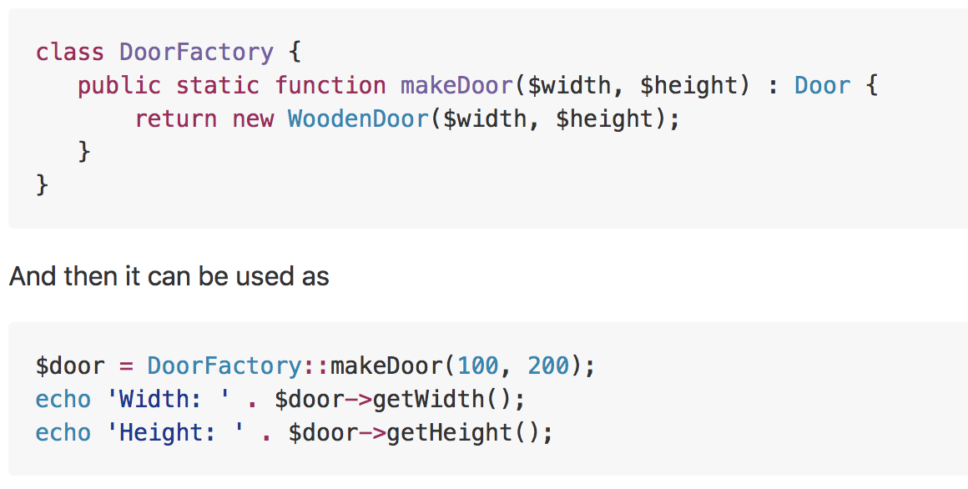
Example
Notes:
When to Use?
When creating an object is not just a few assignments and involves some logic, it makes sense to put it in a dedicated factory instead of repeating the same code everywhere.

Slide 8
Factory Method
Real world example
Consider the case of a hiring manager. It is impossible for one person to interview for each of the positions. Based on the job opening, she has to decide and delegate the interview steps to different people.
In plain words
It provides a way to delegate the instantiation logic to child classes.
Wikipedia says
In class-based programming, the factory method pattern is a creational pattern that uses factory methods to deal with the problem of creating objects without having to specify the exact class of the object that will be created. This is done by creating objects by calling a factory method—either specified in an interface and implemented by child classes, or implemented in a base class and optionally overridden by derived classes—rather than by calling a constructor.

Slide 9
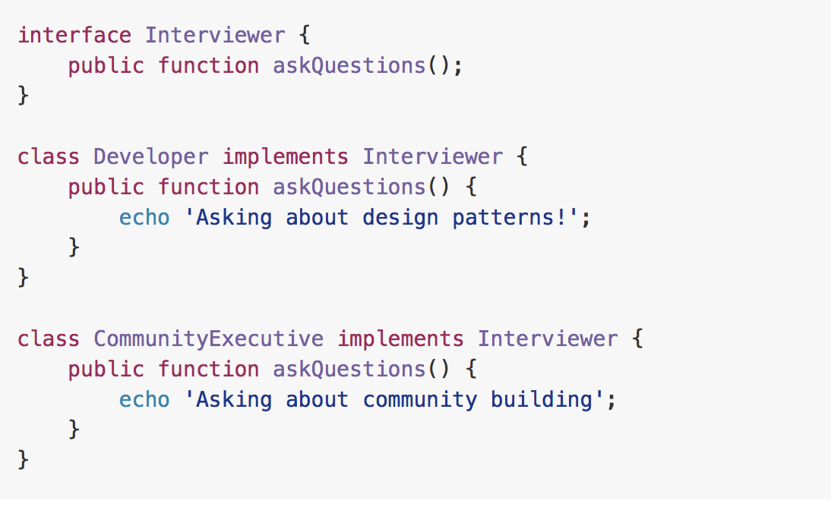
Example

Slide 10
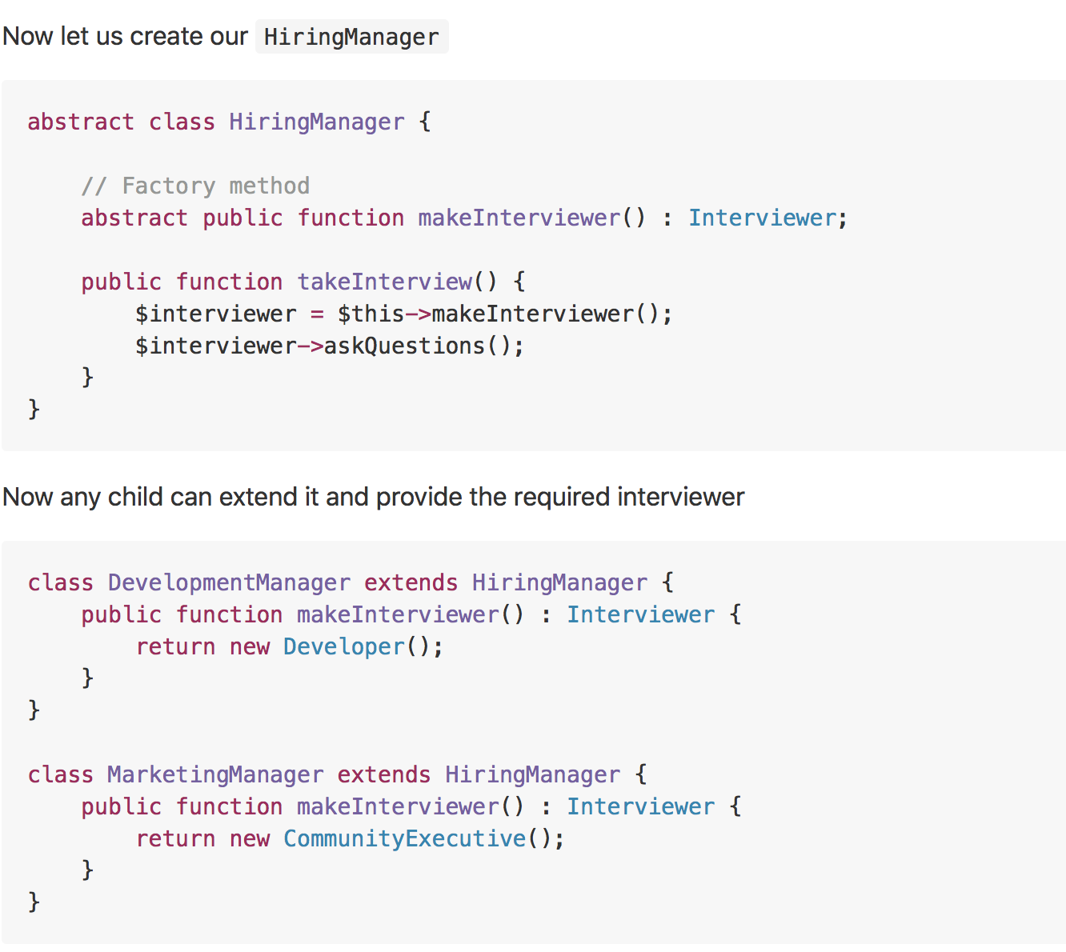
Example

Slide 11
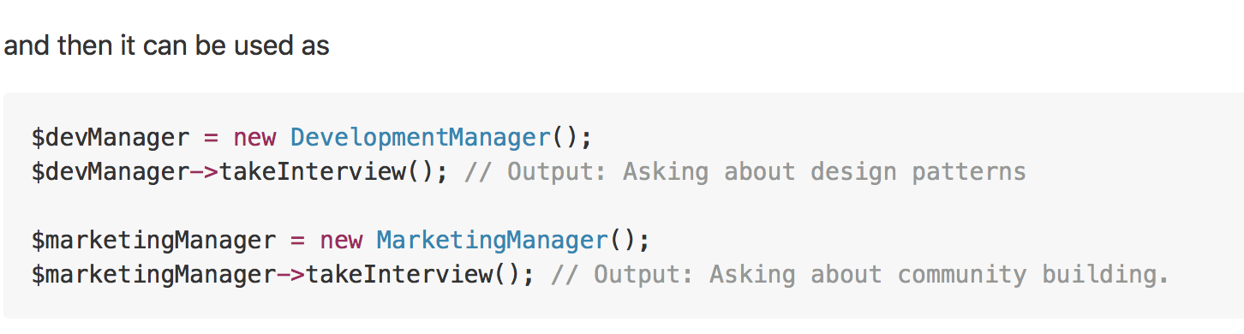
Example
Notes:
When to use?
Useful when there is some generic processing in a class but the required sub-class is dynamically decided at runtime. Or putting it in other words, when the client doesn't know what exact sub-class it might need.

Slide 12
Abstract Factory
Real world example
Extending our door example from Simple Factory. Based on your needs you might get a wooden door from a wooden door shop, iron door from an iron shop or a PVC door from the relevant shop. Plus you might need a guy with different kind of specialties to fit the door, for example a carpenter for wooden door, welder for iron door etc. As you can see there is a dependency between the doors now, wooden door needs carpenter, iron door needs a welder etc.
In plain words
A factory of factories; a factory that groups the individual but related/dependent factories together without specifying their concrete classes.
Wikipedia says
The abstract factory pattern provides a way to encapsulate a group of individual factories that have a common theme without specifying their concrete classes

Slide 13
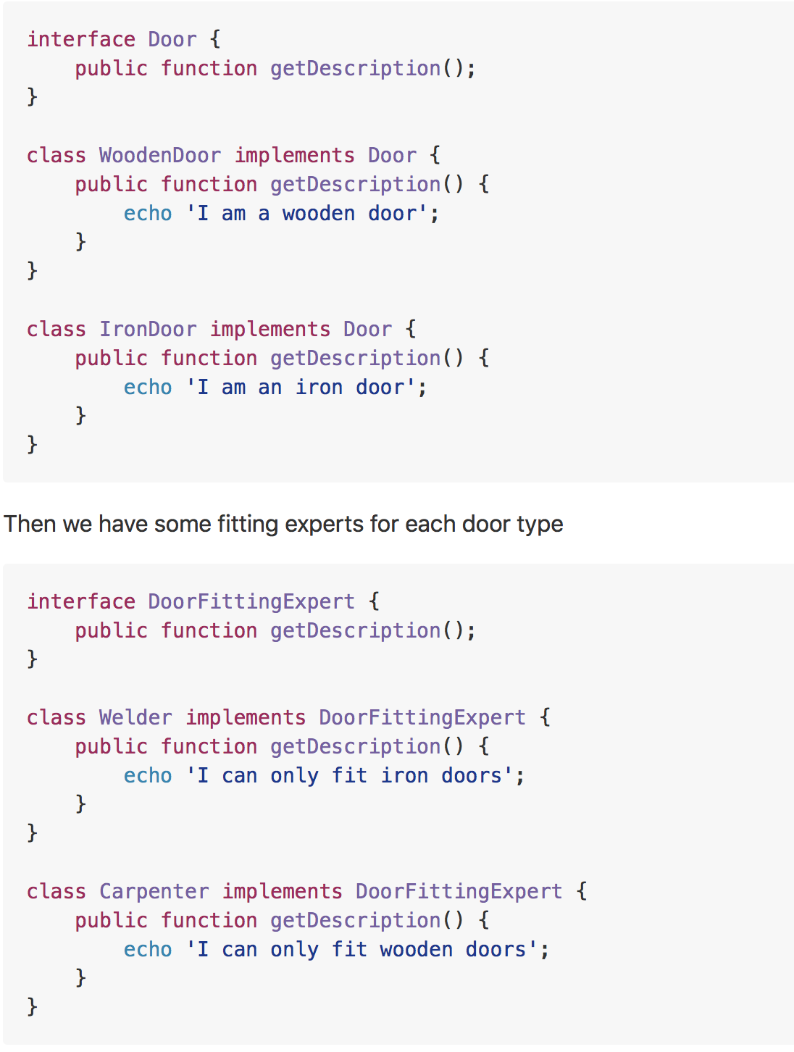
Example

Slide 14
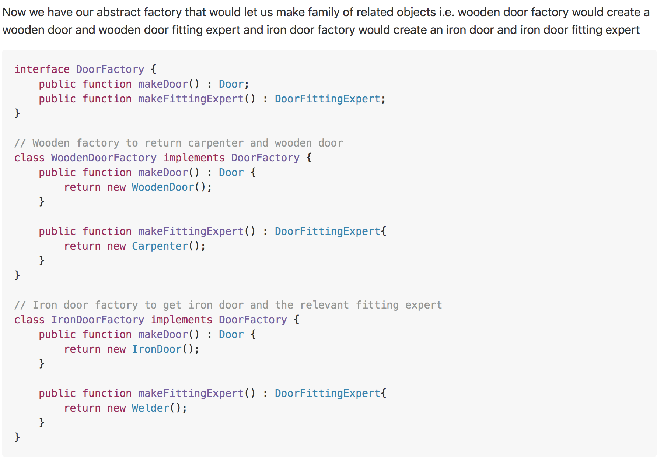
Example

Slide 15
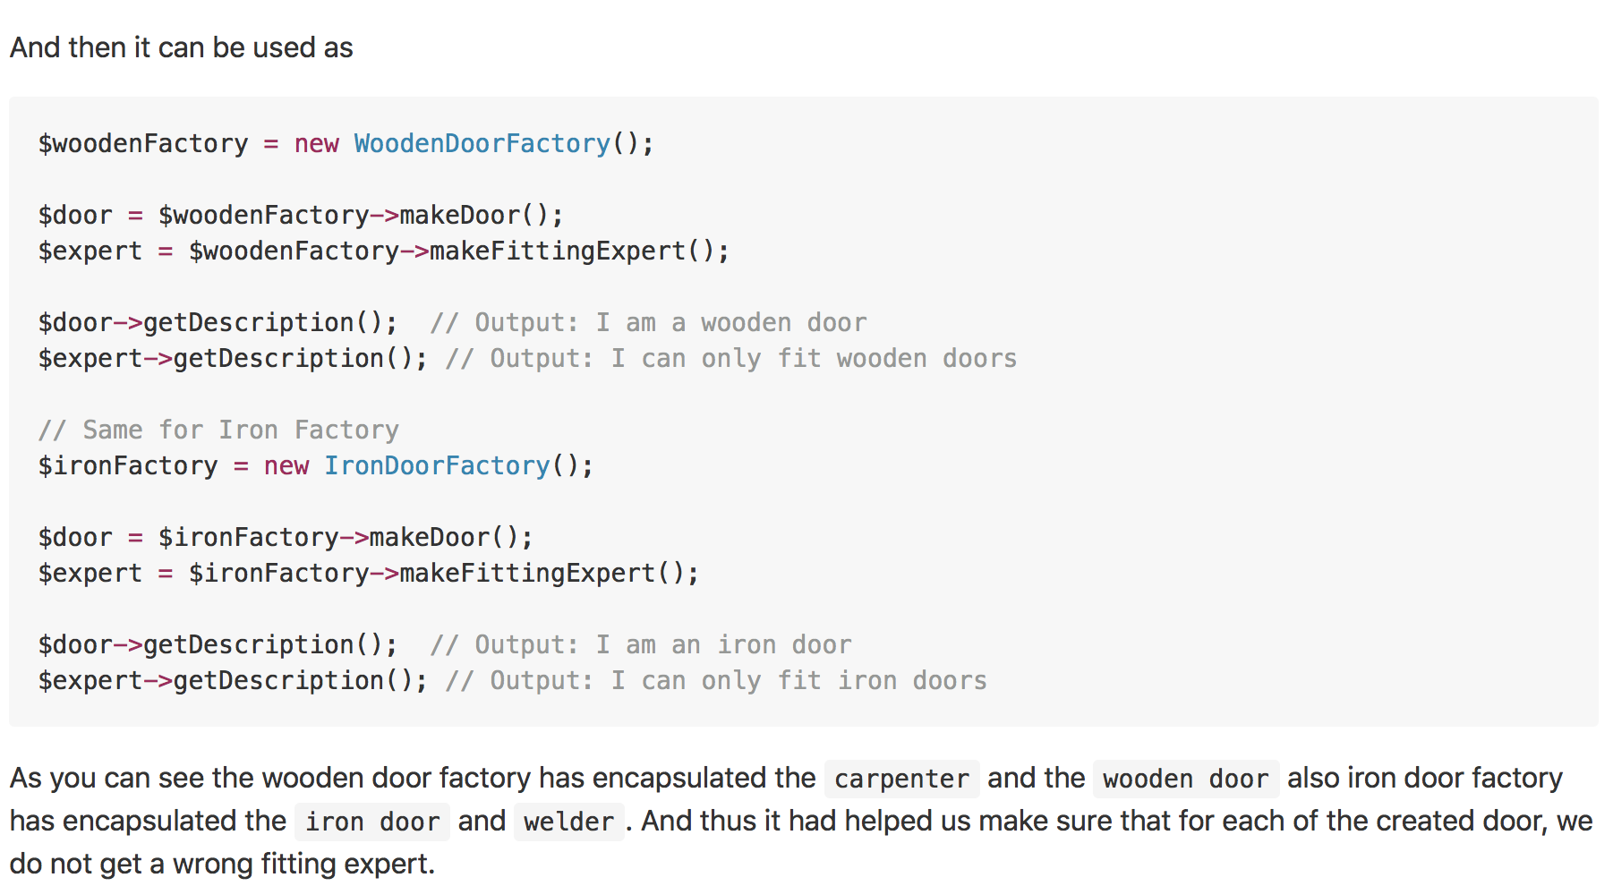
Example
Notes:
When there are interrelated dependencies with not-that-simple creation logic involved

Slide 16
Builder
Real world example
Imagine you are at Hardee's and you order a specific deal, lets say, "Big Hardee" and they hand it over to you without any questions; this is the example of simple factory. But there are cases when the creation logic might involve more steps. For example you want a customized Subway deal, you have several options in how your burger is made e.g what bread do you want? what types of sauces would you like? What cheese would you want? etc. In such cases builder pattern comes to the rescue.
In plain words
Allows you to create different flavors of an object while avoiding constructor pollution. Useful when there could be several flavors of an object. Or when there are a lot of steps involved in creation of an object.
Wikipedia says
The builder pattern is an object creation software design pattern with the intentions of finding a solution to the telescoping constructor anti-pattern.

Slide 17
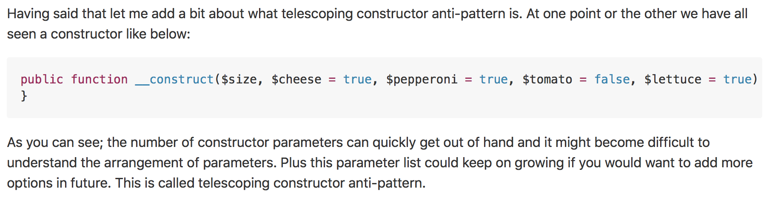
Why?

Slide 18
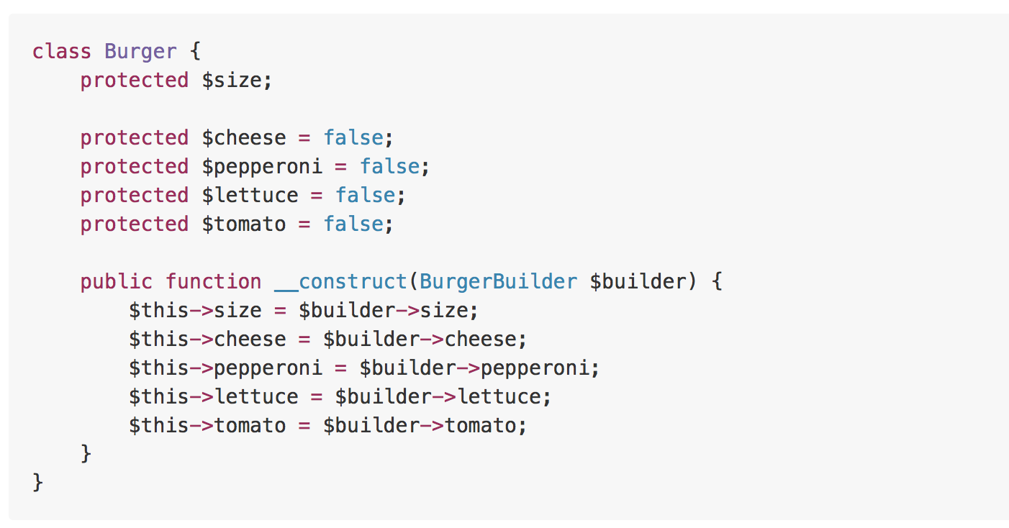
Example

Slide 19
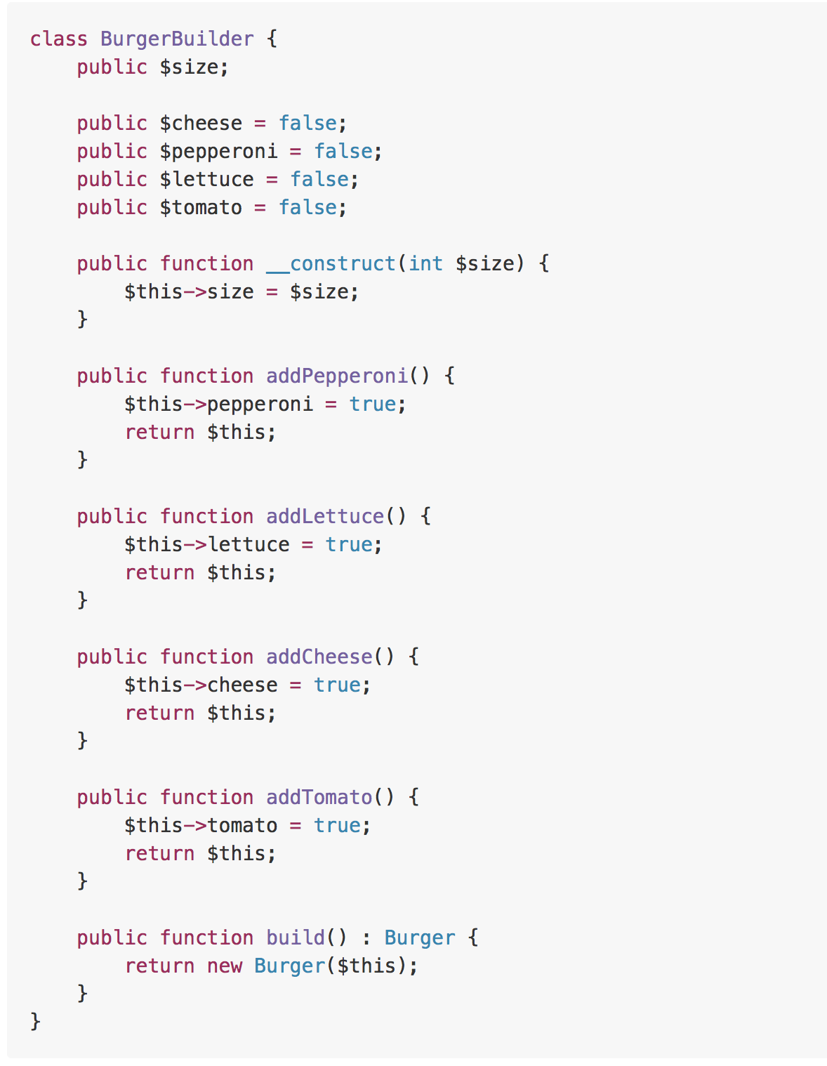
Example

Slide 20
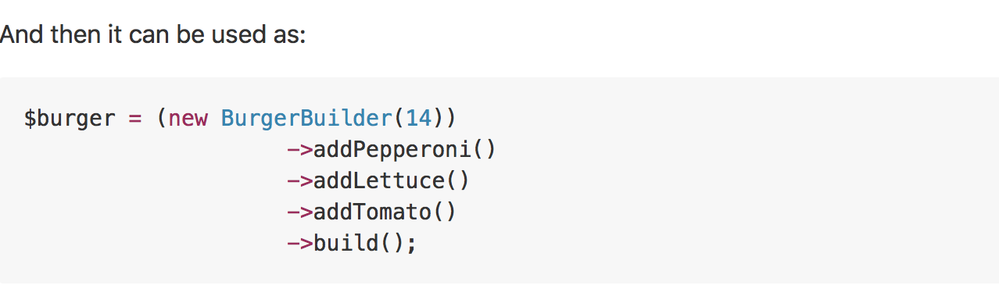
Example
Notes:
When to use?
When there could be several flavors of an object and to avoid the constructor telescoping. The key difference from the factory pattern is that; factory pattern is to be used when the creation is a one step process while builder pattern is to be used when the creation is a multi step process.

Slide 21
Prototype
Real world example
Remember dolly? The sheep that was cloned! Lets not get into the details but the key point here is that it is all about cloning
In plain words
Create object based on an existing object through cloning.
Wikipedia says
The prototype pattern is a creational design pattern in software development. It is used when the type of objects to create is determined by a prototypical instance, which is cloned to produce new objects.

Slide 22
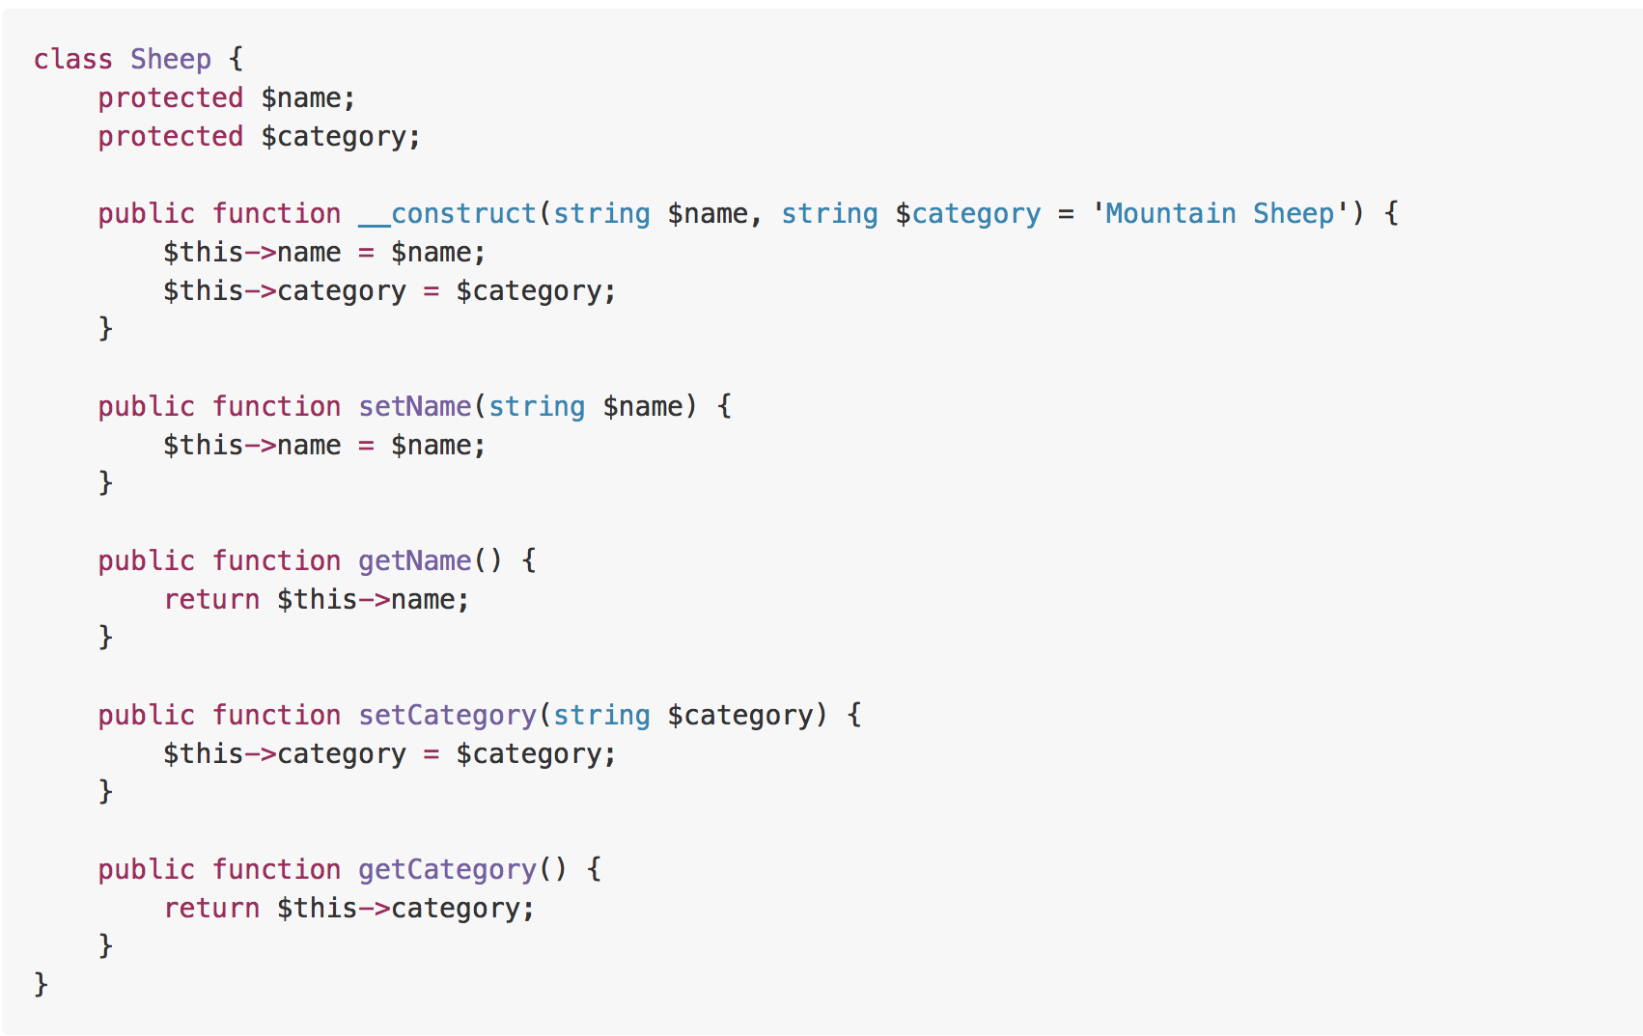
Example

Slide 23
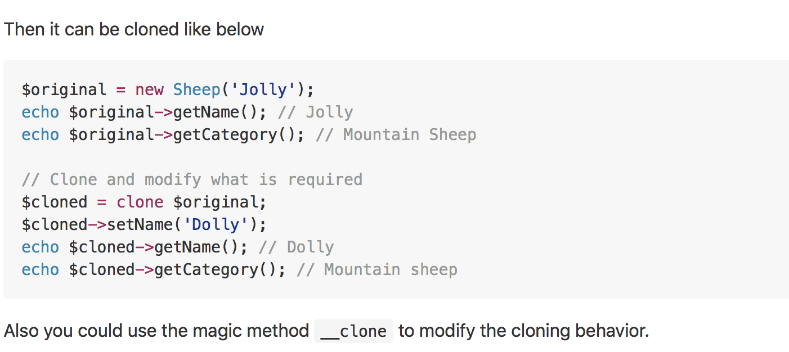
Example
Notes:
When to use?
When an object is required that is similar to existing object or when the creation would be expensive as compared to cloning.

Slide 24
Singleton
Real world example
There can only be one president of a country at a time. The same president has to be brought to action, whenever duty calls. President here is singleton.
In plain words
Ensures that only one object of a particular class is ever created.
Wikipedia says
In software engineering, the singleton pattern is a software design pattern that restricts the instantiation of a class to one object. This is useful when exactly one object is needed to coordinate actions across the system.
Notes:
Singleton pattern is actually considered an anti-pattern and overuse of it should be avoided. It is not necessarily bad and could have some valid use-cases but should be used with caution because it introduces a global state in your application and change to it in one place could affect in the other areas and it could become pretty difficult to debug. The other bad thing about them is it makes your code tightly coupled plus it mocking the singleton could be difficult.

Slide 25
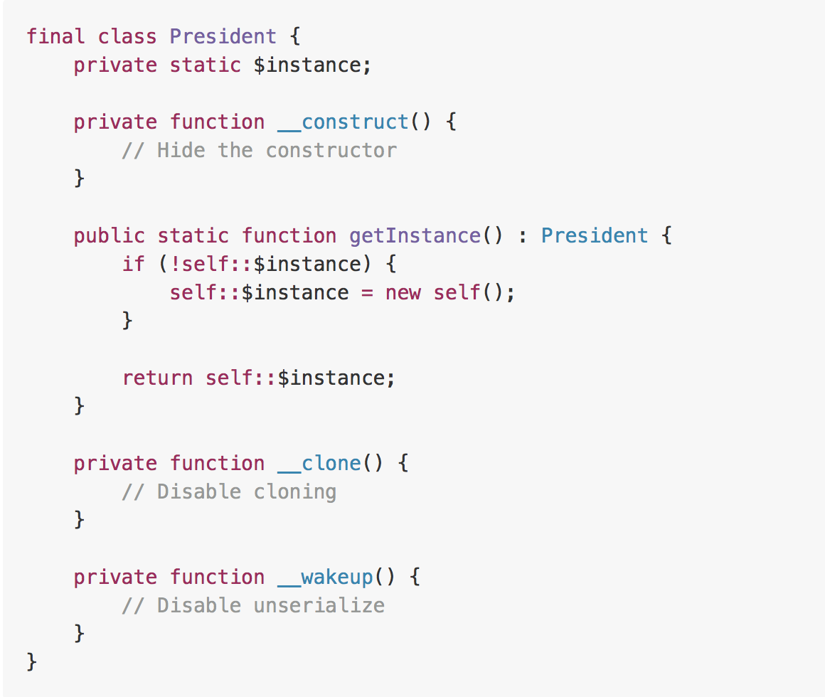
Example

Slide 26
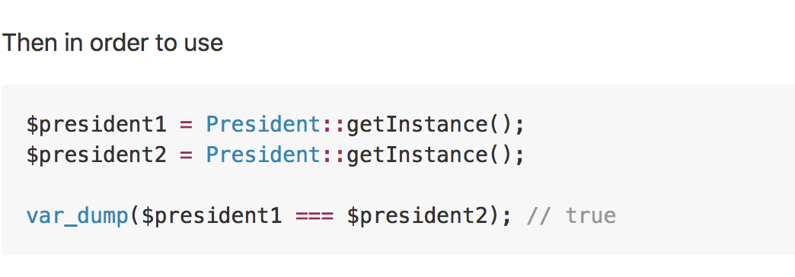
Example

Slide 27
Structural
In software engineering, structural design patterns are design patterns that ease the design by identifying a simple way to realize relationships between entities.
Notes:
Structural patterns are mostly concerned with object composition or in other words how the entities can use each other. Or yet another explanation would be, they help in answering "How to build a software component?"

Slide 28
Adapter
Real world example
Consider that you have some pictures in your memory card and you need to transfer them to your computer. In order to transfer them you need some kind of adapter that is compatible with your computer ports so that you can attach memory card to your computer. In this case card reader is an adapter. Another example would be the famous power adapter; a three legged plug can't be connected to a two pronged outlet, it needs to use a power adapter that makes it compatible with the two pronged outlet. Yet another example would be a translator translating words spoken by one person to another
In plain words
Adapter pattern lets you wrap an otherwise incompatible object in an adapter to make it compatible with another class.
Wikipedia says
In software engineering, the adapter pattern is a software design pattern that allows the interface of an existing class to be used as another interface. It is often used to make existing classes work with others without modifying their source code.

Slide 29
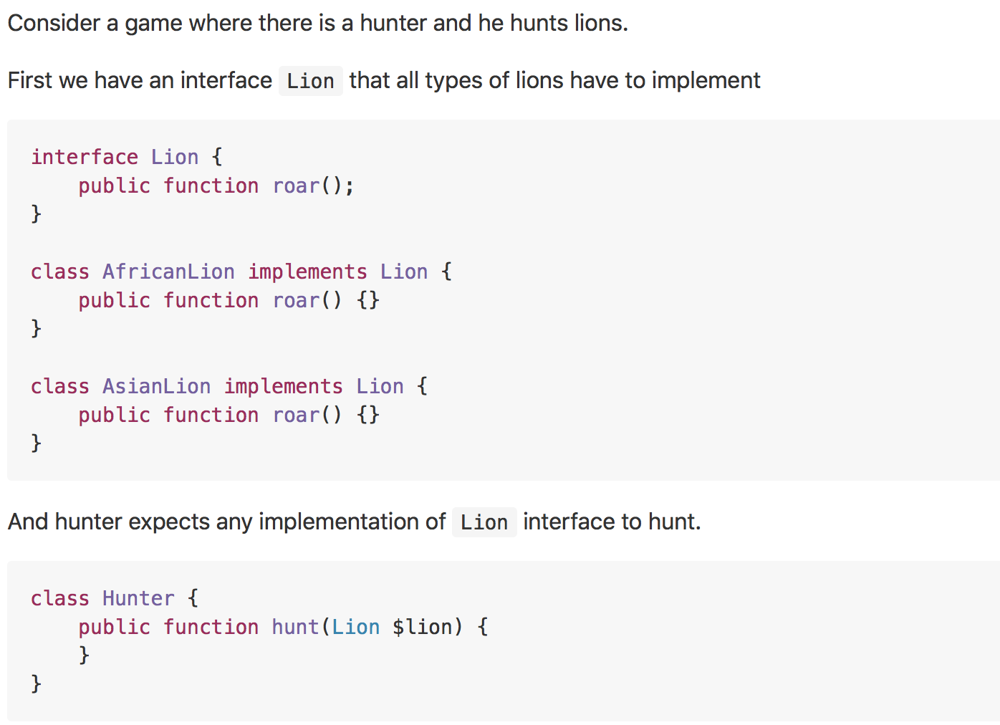
Example

Slide 30
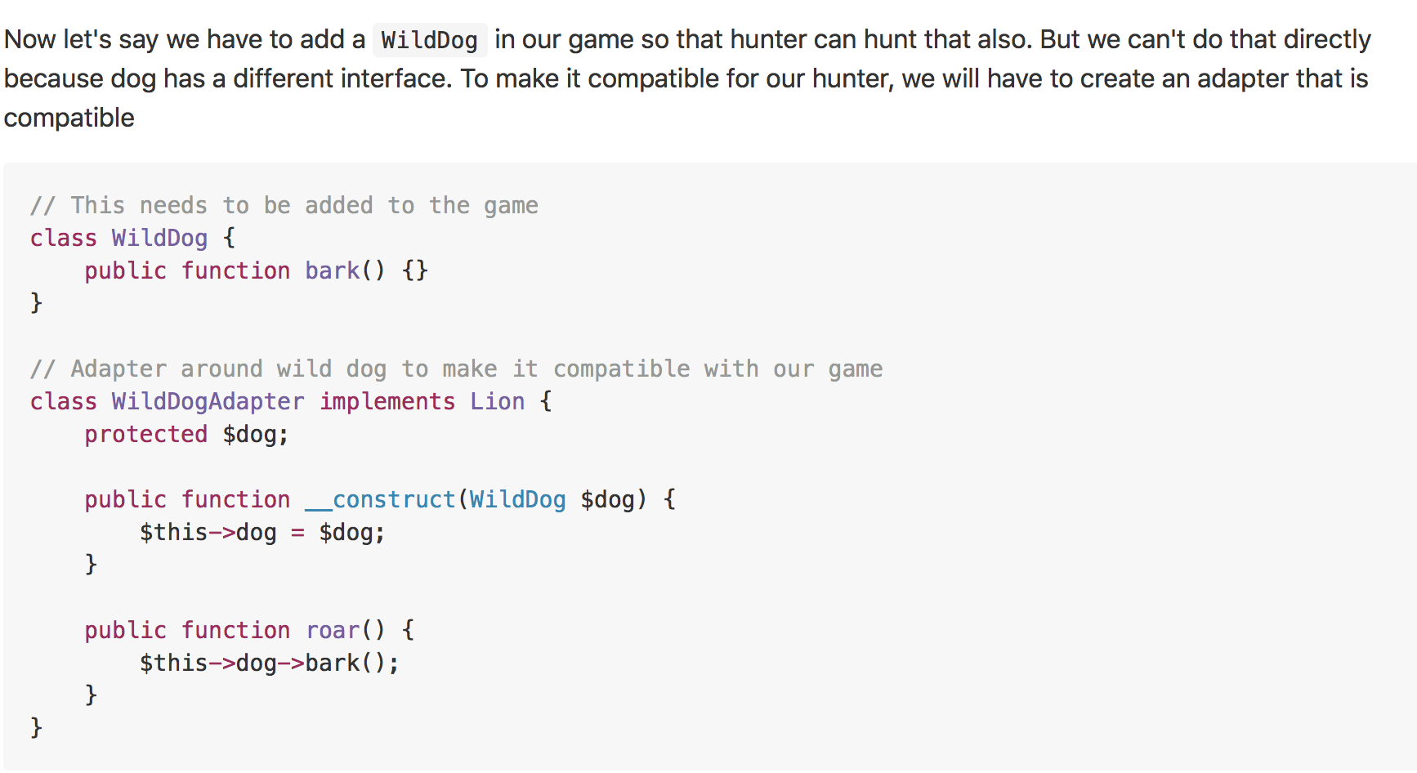
Example

Slide 31
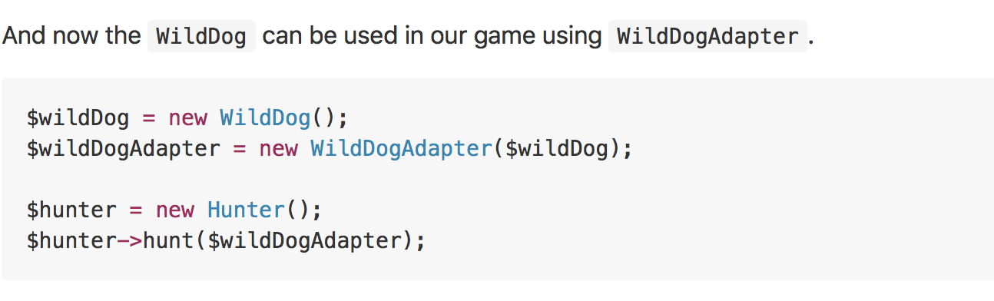
Example

Slide 32
Bridge
Real world example
Consider you have a website with different pages and you are supposed to allow the user to change the theme. What would you do? Create multiple copies of each of the pages for each of the themes or would you just create separate theme and load them based on the user's preferences?
In Plain Words
Bridge pattern is about preferring composition over inheritance. Implementation details are pushed from a hierarchy to another object with a separate hierarchy.
Wikipedia says
The bridge pattern is a design pattern used in software engineering that is meant to "decouple an abstraction from its implementation so that the two can vary independently"

Slide 33
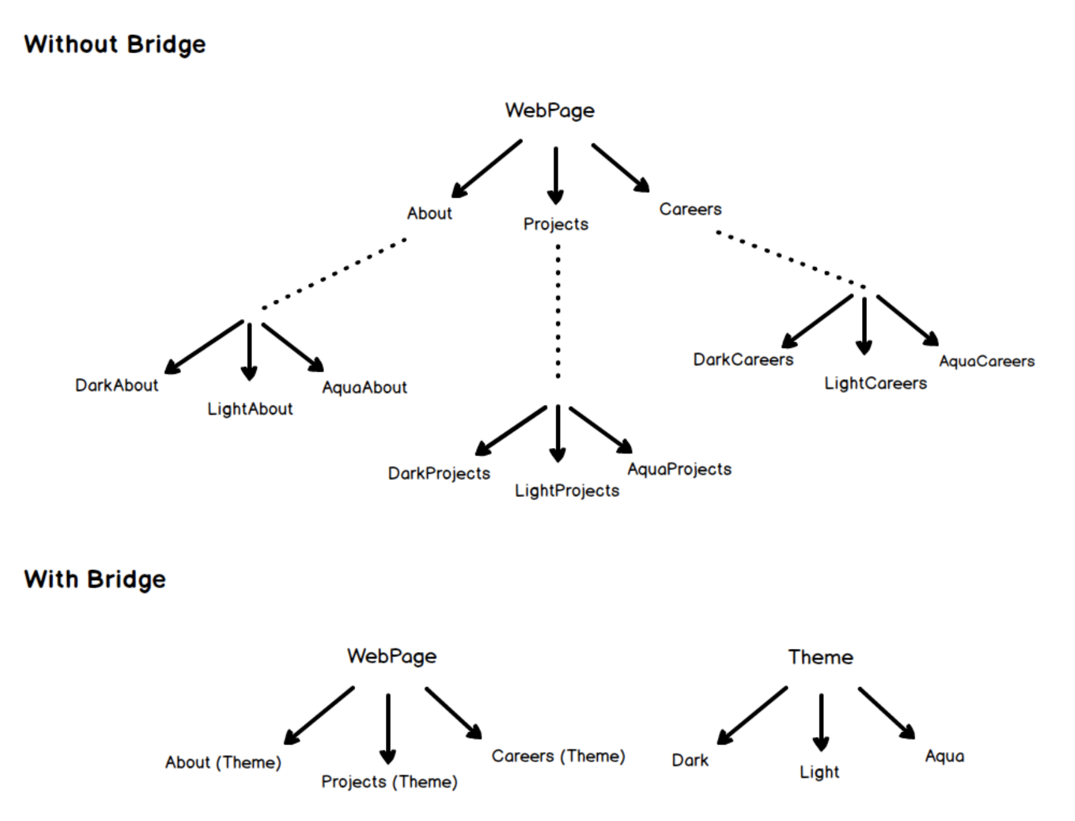
Bridge

Slide 34
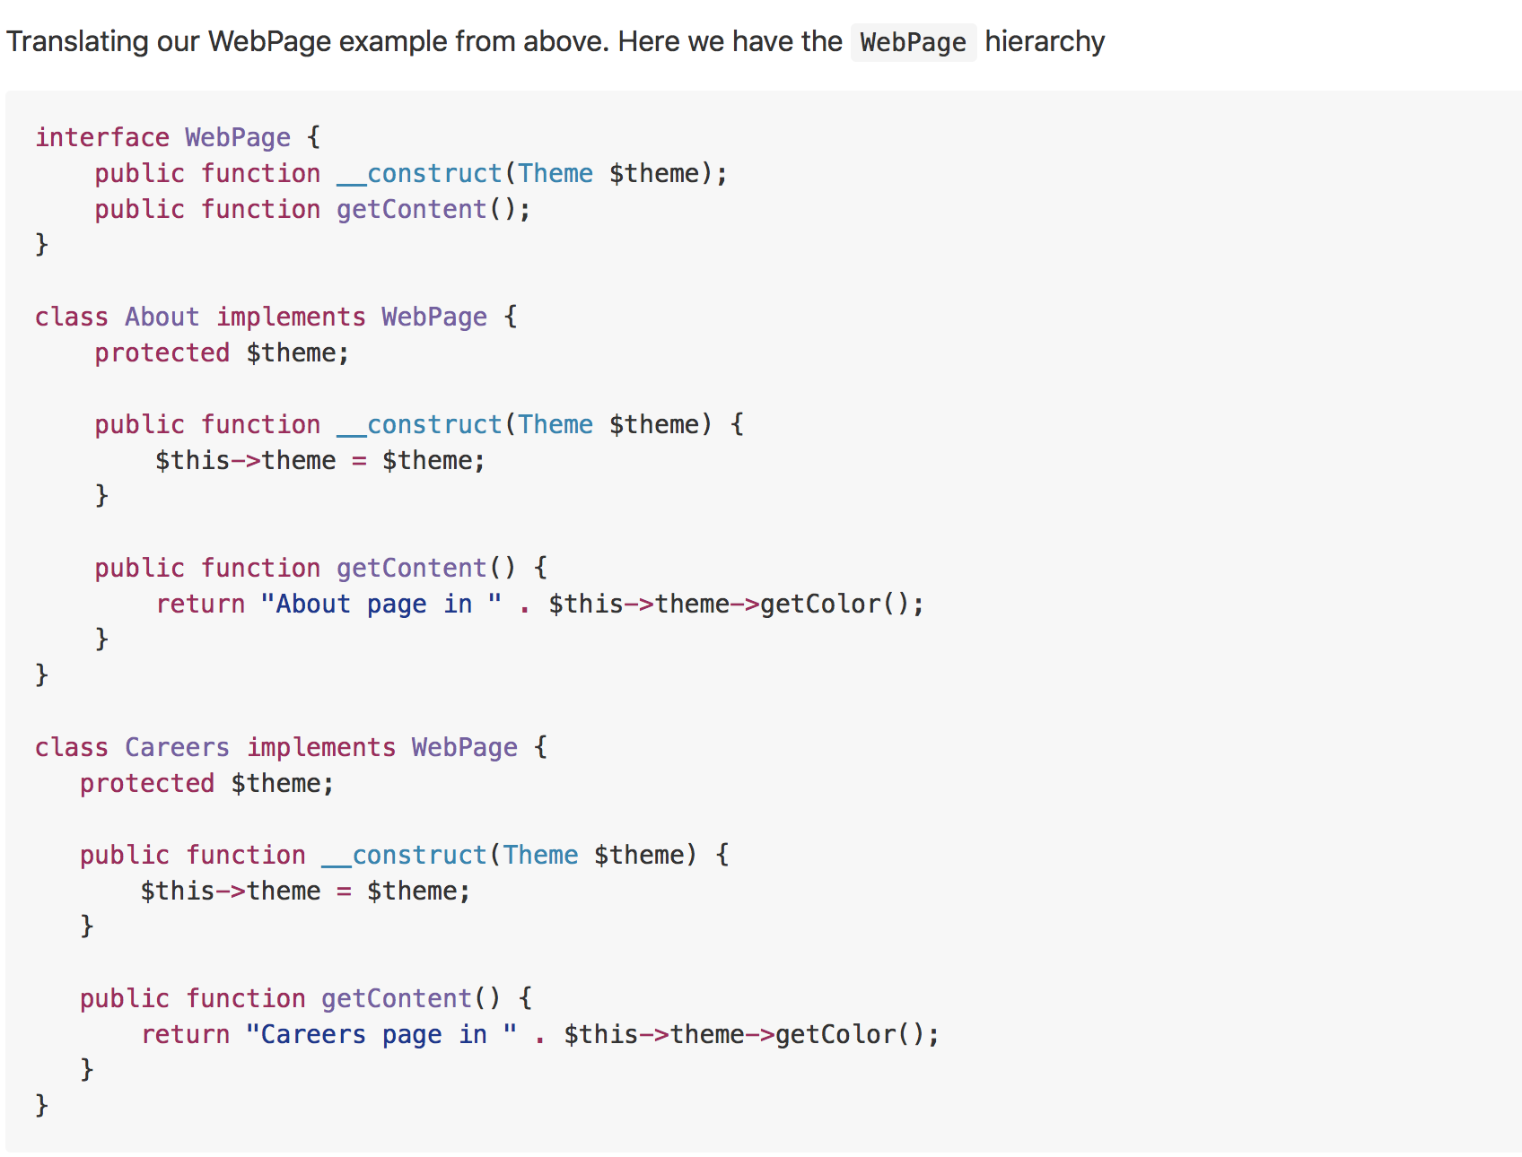
Example

Slide 35
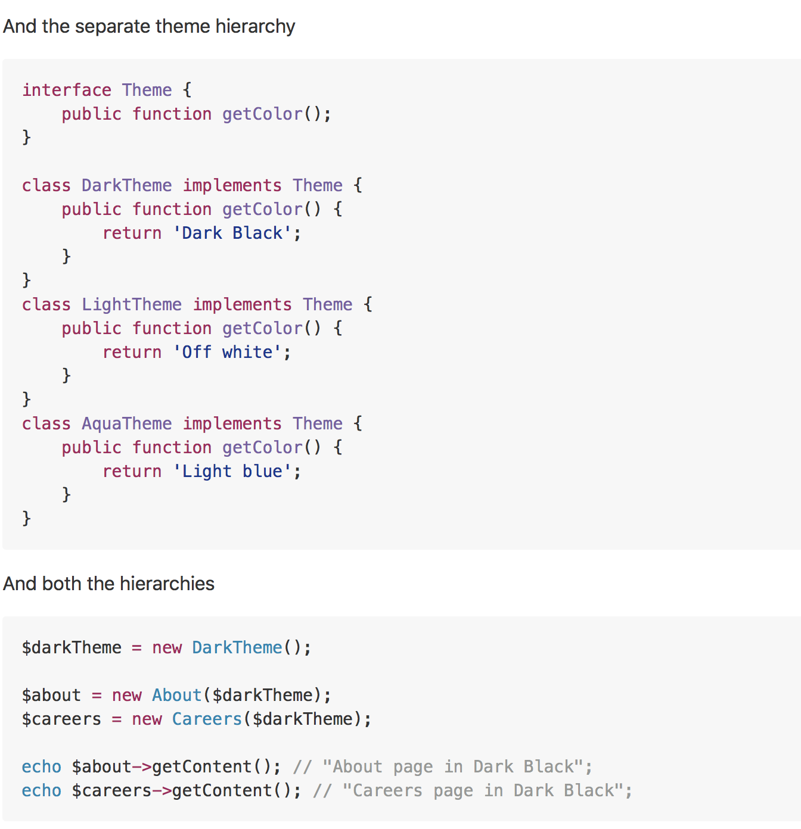
Example

Slide 36
Composite
Real world example
Every organization is composed of employees. Each of the employees has same features i.e. has a salary, has some responsibilities, may or may not report to someone, may or may not have some subordinates etc.
In plain words
Composite pattern lets clients to treat the individual objects in a uniform manner.
Wikipedia says
In software engineering, the composite pattern is a partitioning design pattern. The composite pattern describes that a group of objects is to be treated in the same way as a single instance of an object. The intent of a composite is to "compose" objects into tree structures to represent part-whole hierarchies. Implementing the composite pattern lets clients treat individual objects and compositions uniformly.

Slide 37
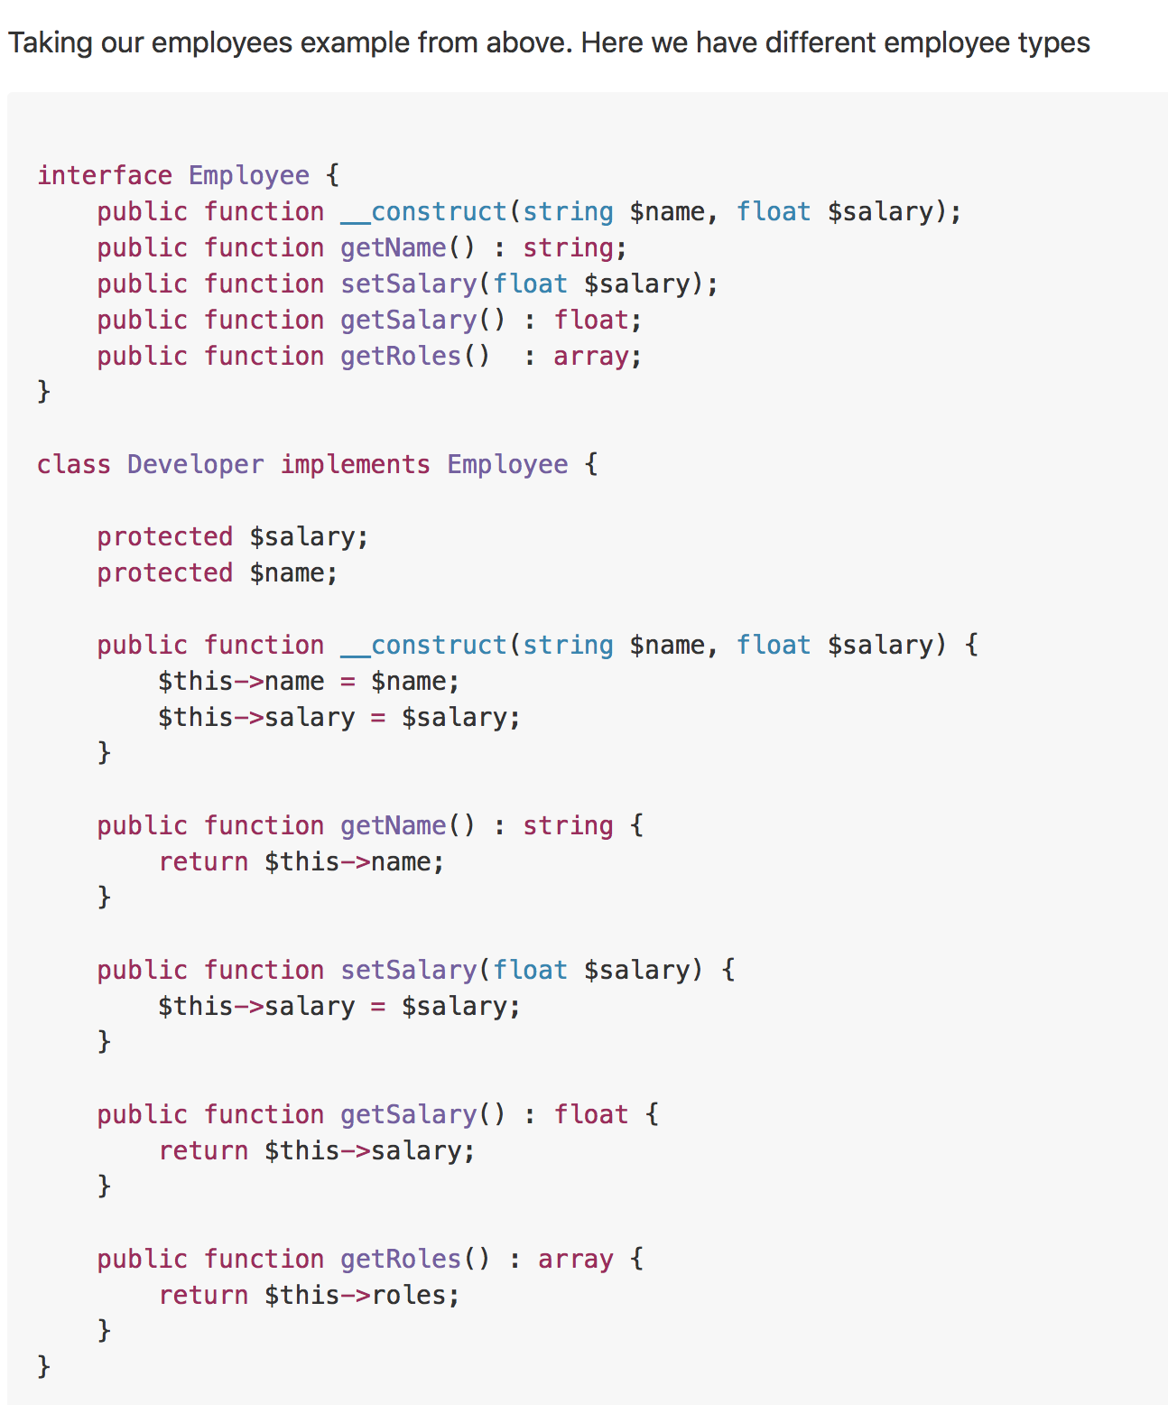
Example

Slide 38
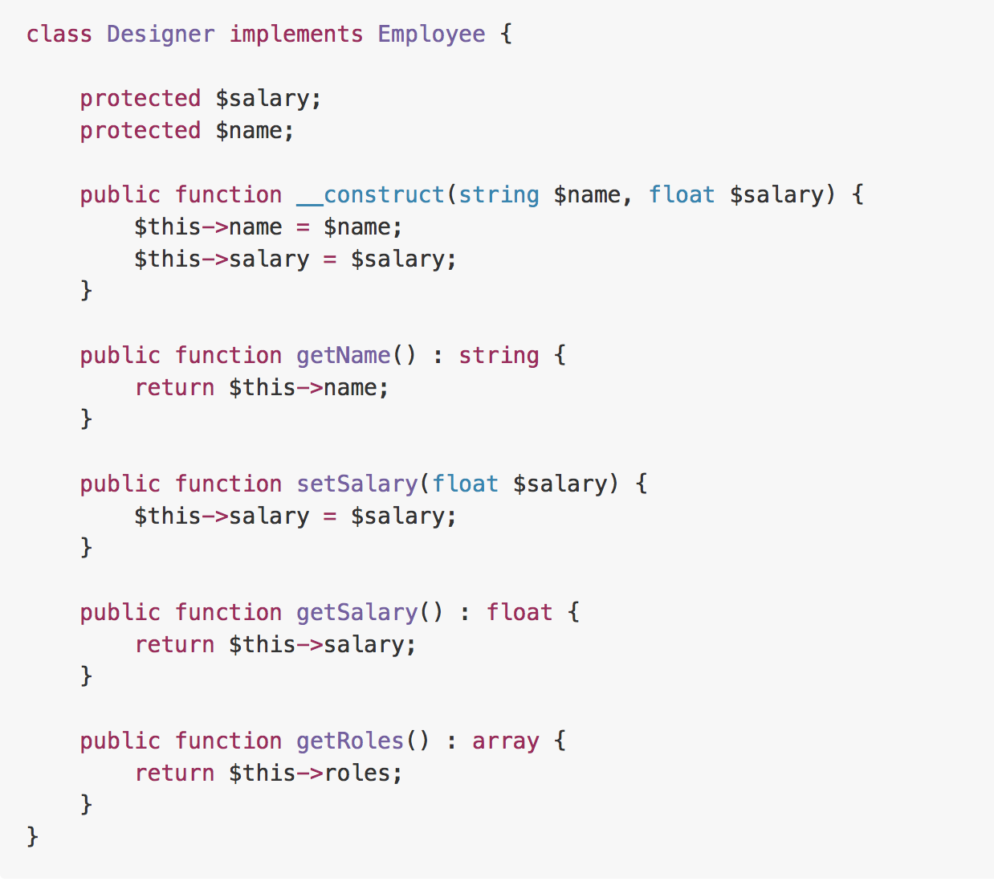
Example

Slide 39
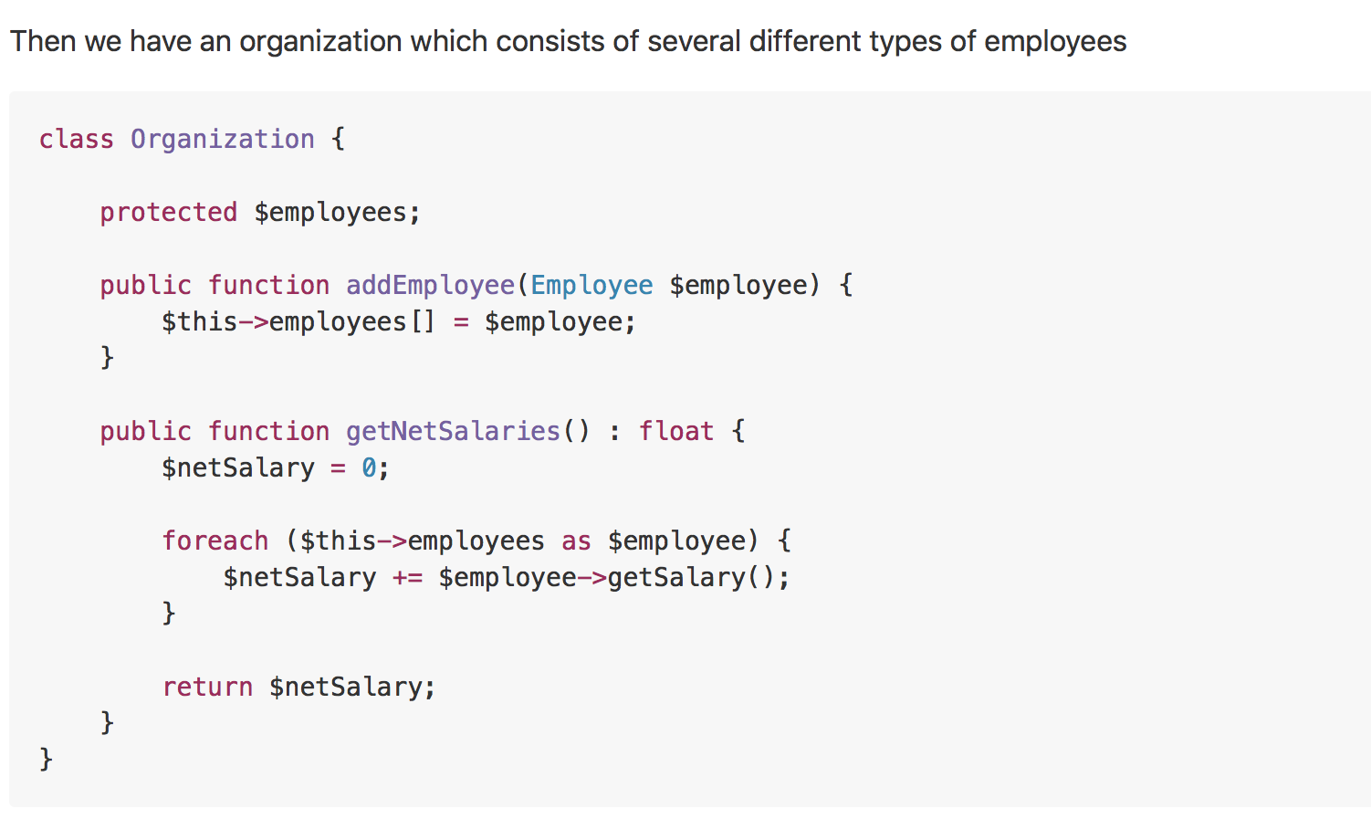
Example

Slide 40
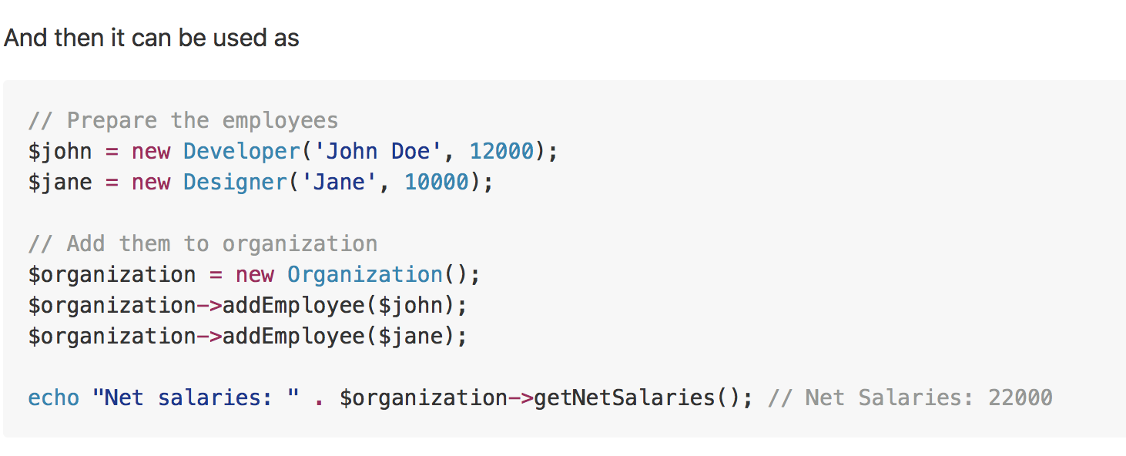
Example

Slide 41
Decorator
Real world example
Imagine you run a car service shop offering multiple services. Now how do you calculate the bill to be charged? You pick one service and dynamically keep adding to it the prices for the provided services till you get the final cost. Here each type of service is a decorator.
In plain words
Decorator pattern lets you dynamically change the behavior of an object at run time by wrapping them in an object of a decorator class.
Wikipedia says
In object-oriented programming, the decorator pattern is a design pattern that allows behavior to be added to an individual object, either statically or dynamically, without affecting the behavior of other objects from the same class. The decorator pattern is often useful for adhering to the Single Responsibility Principle, as it allows functionality to be divided between classes with unique areas of concern.

Slide 42
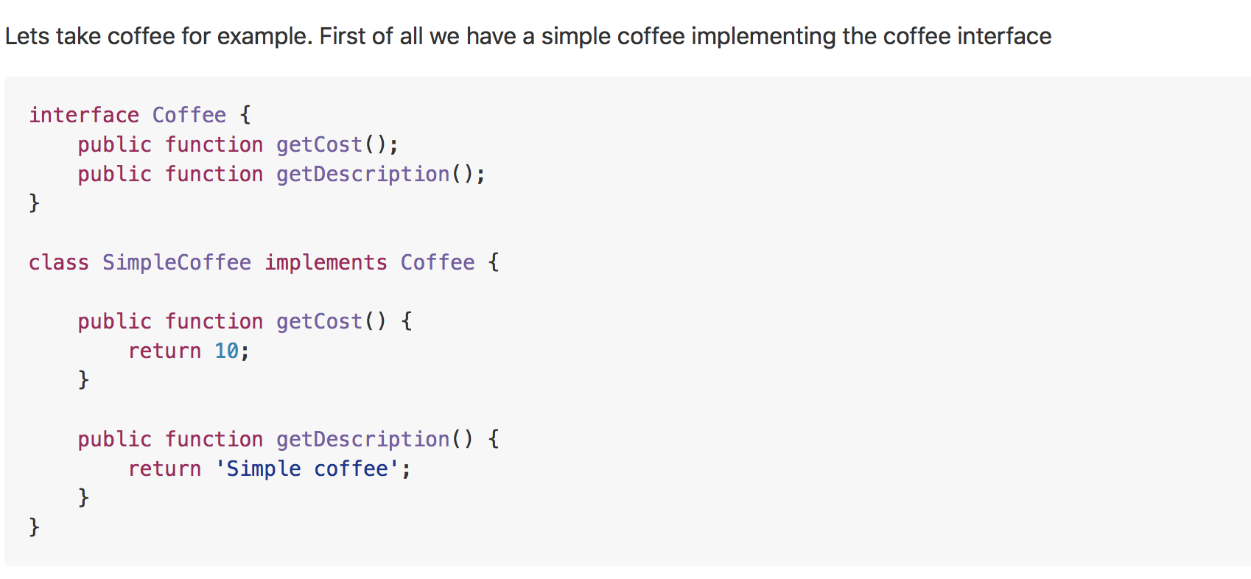
Example

Slide 43
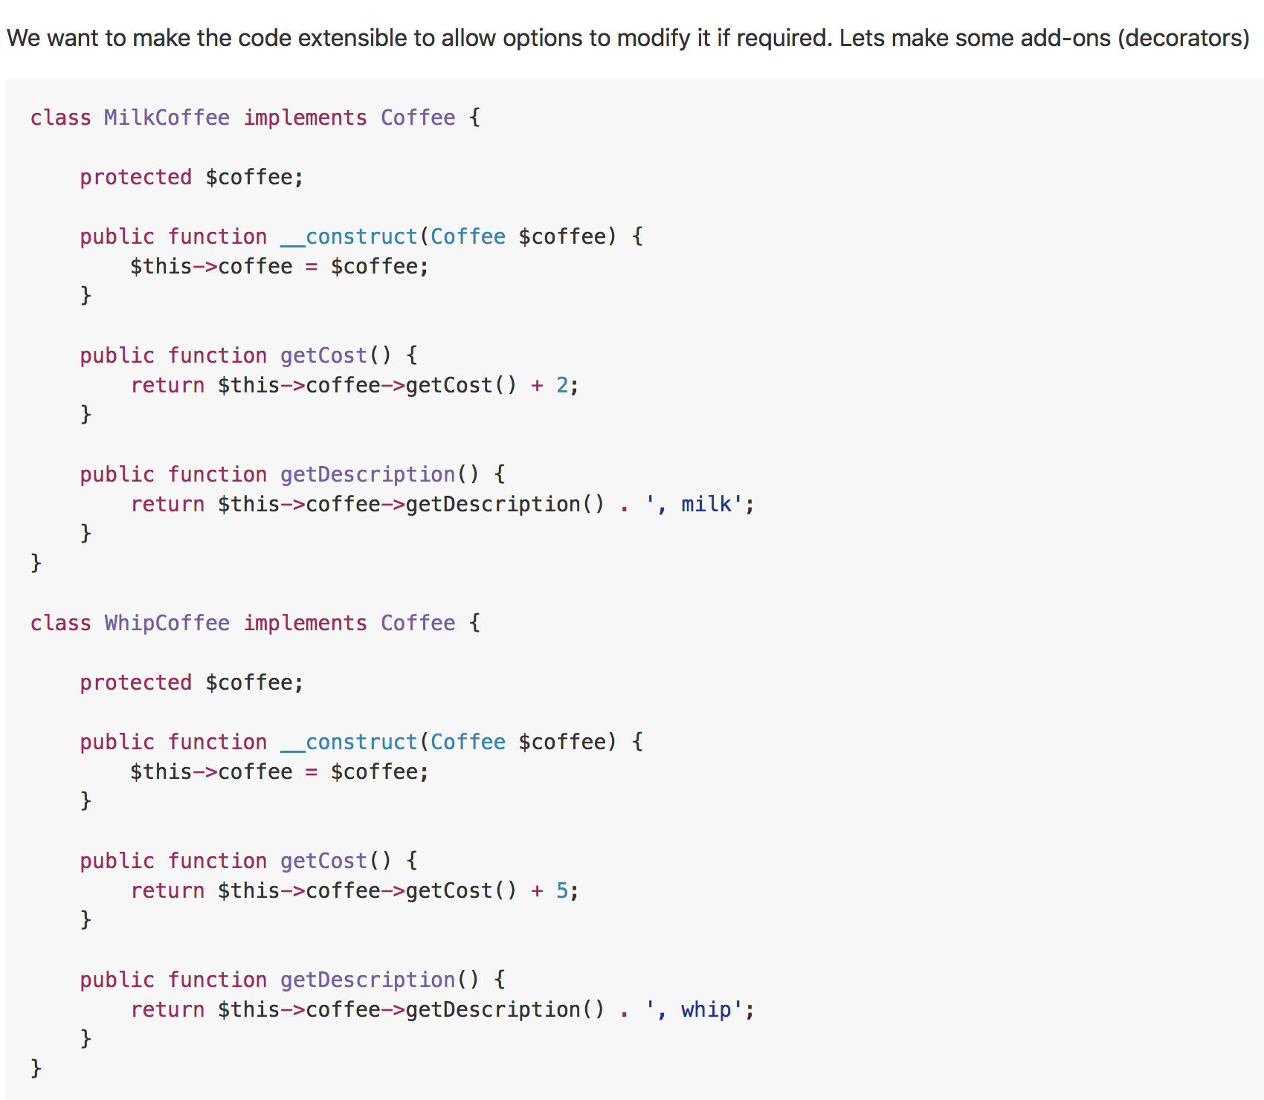
Example

Slide 44
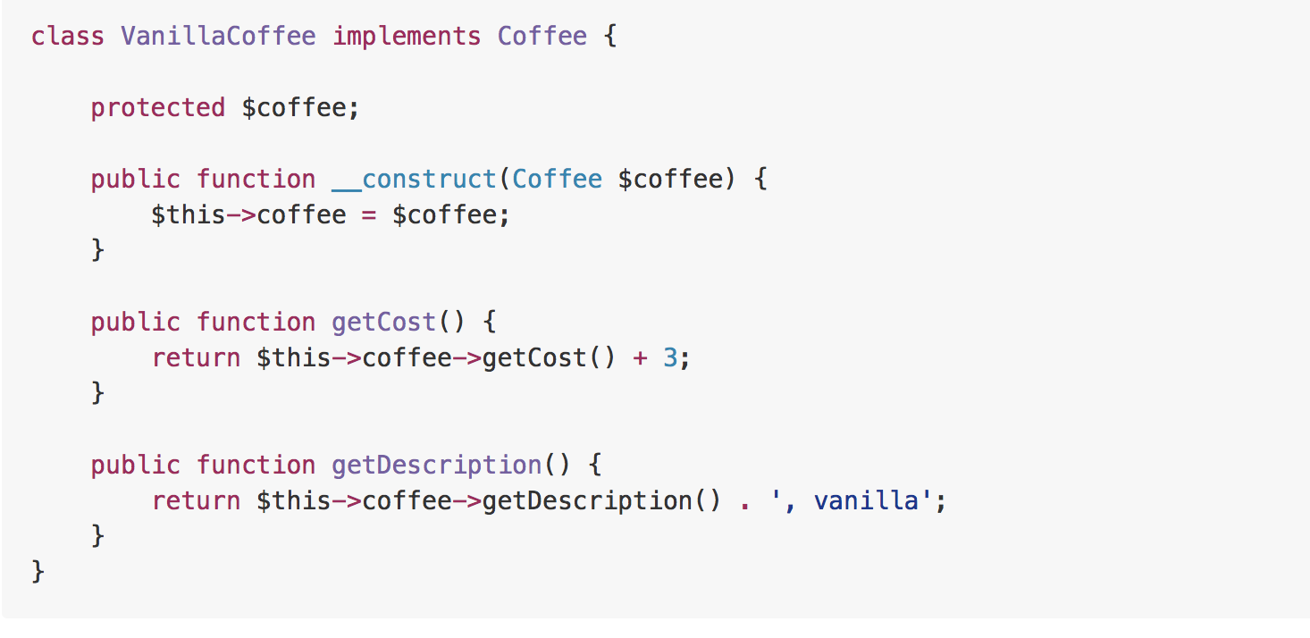
Example

Slide 45
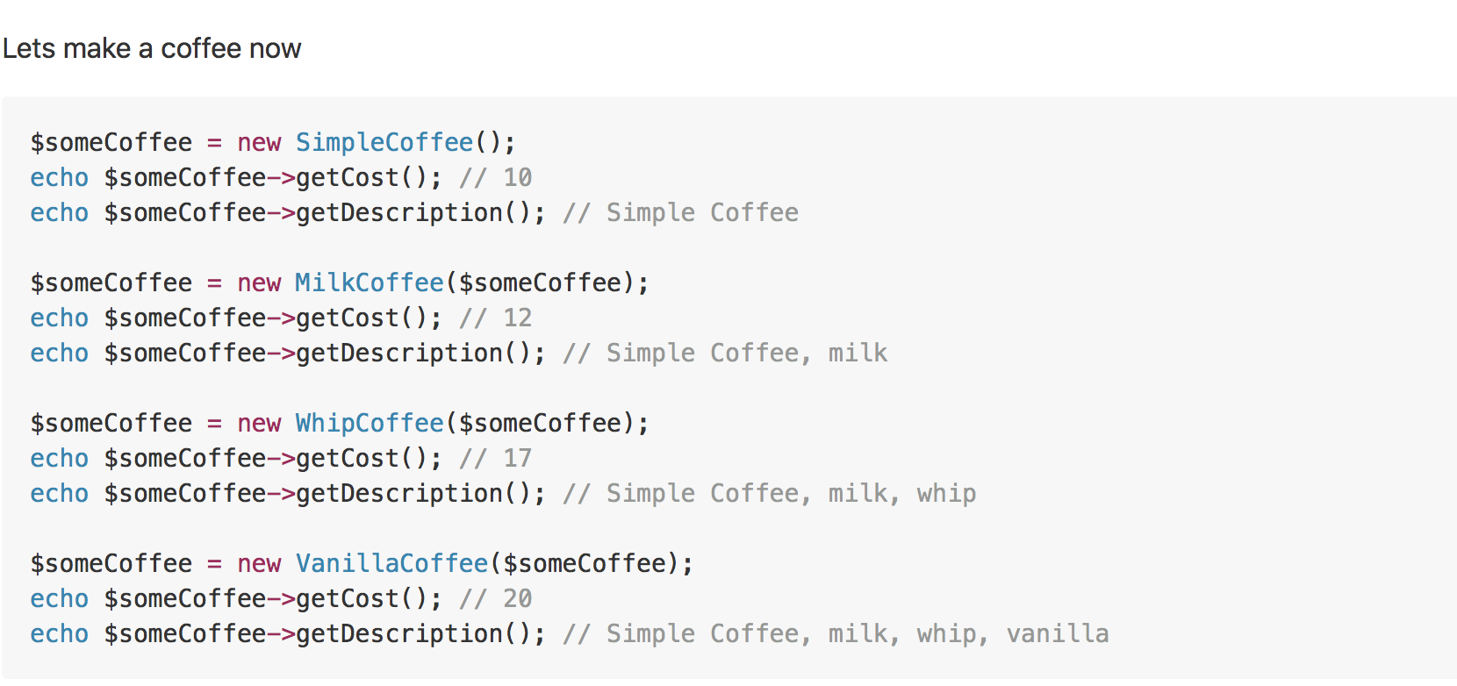
Example

Slide 46
Façade
Real world example
How do you turn on the computer? "Hit the power button" you say! That is what you believe because you are using a simple interface that computer provides on the outside, internally it has to do a lot of stuff to make it happen. This simple interface to the complex subsystem is a facade.
In plain words
Facade pattern provides a simplified interface to a complex subsystem.
Wikipedia says
A facade is an object that provides a simplified interface to a larger body of code, such as a class library.

Slide 47
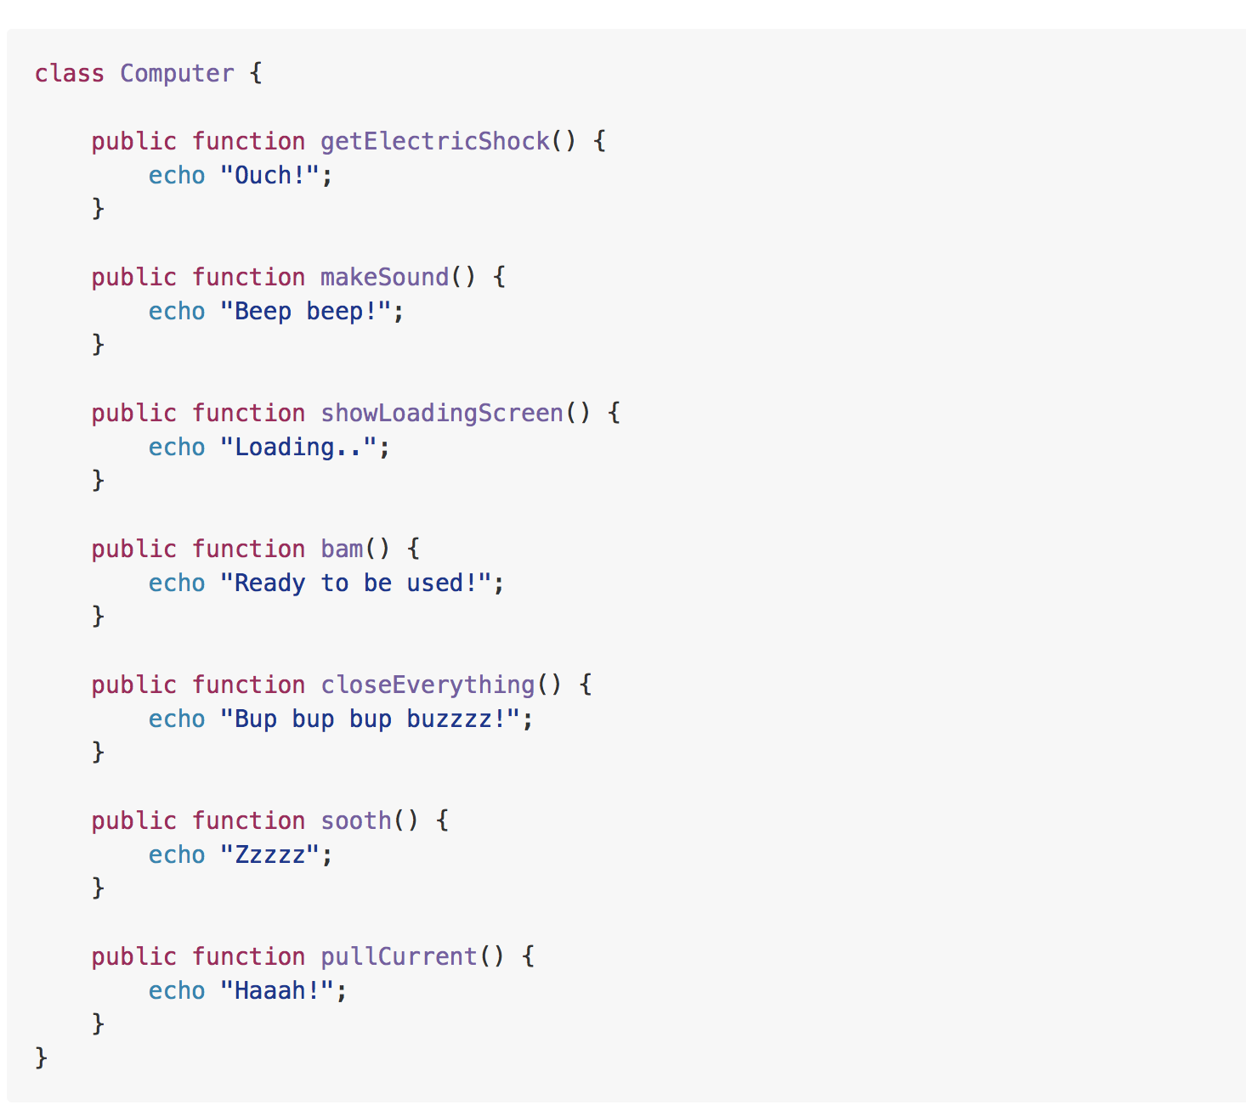
Example

Slide 48
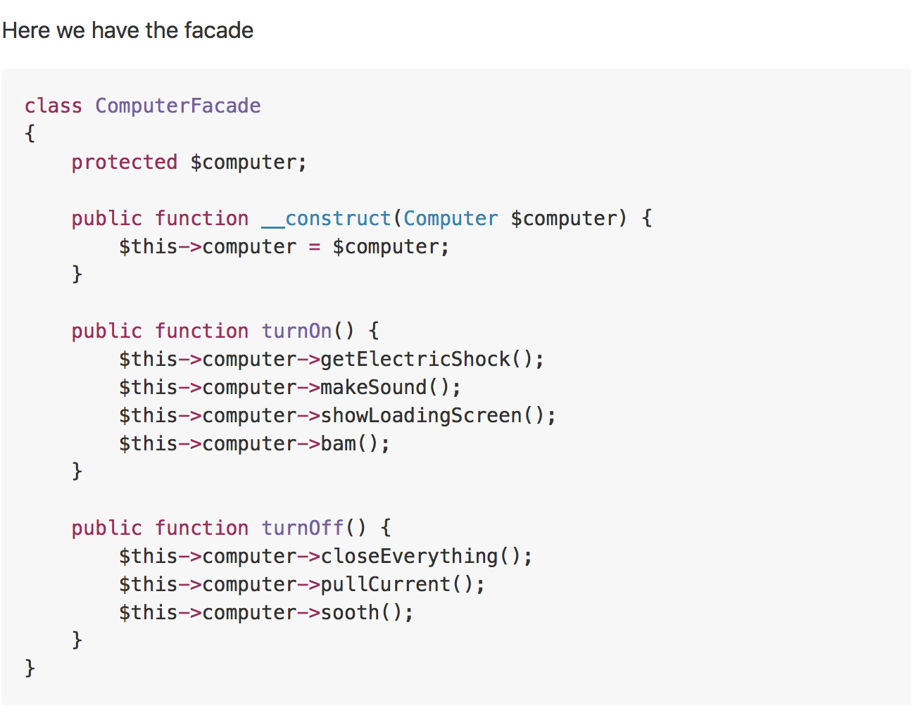
Example

Slide 49
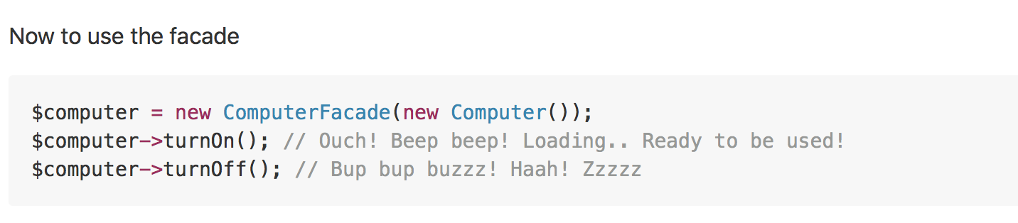
Example

Slide 50
Flyweight
Real world example
Did you ever have fresh tea from some stall? They often make more than one cup that you demanded and save the rest for any other customer so to save the resources e.g. gas etc. Flyweight pattern is all about that i.e. sharing.
In plain words
It is used to minimize memory usage or computational expenses by sharing as much as possible with similar objects.
Wikipedia says
In computer programming, flyweight is a software design pattern. A flyweight is an object that minimizes memory use by sharing as much data as possible with other similar objects; it is a way to use objects in large numbers when a simple repeated representation would use an unacceptable amount of memory.

Slide 51
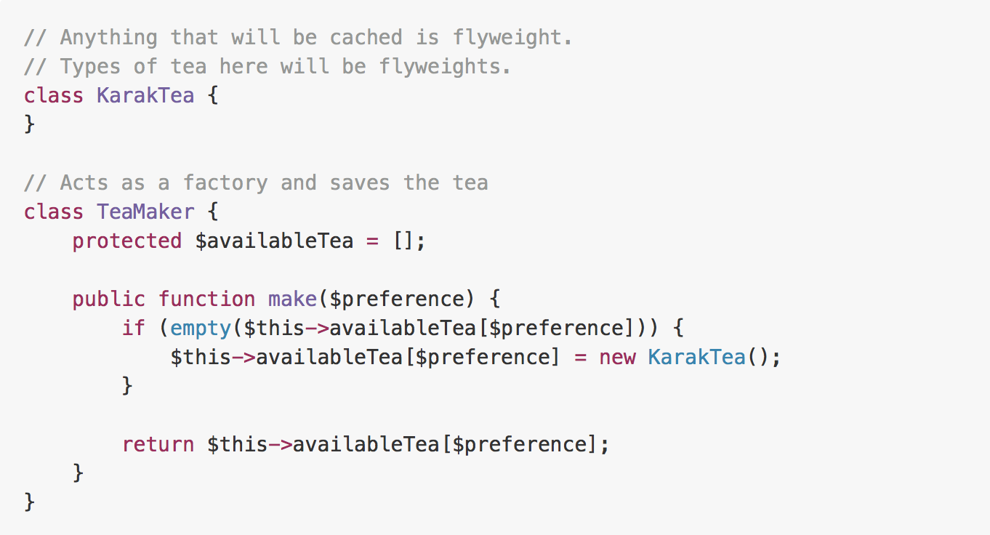
Example

Slide 52
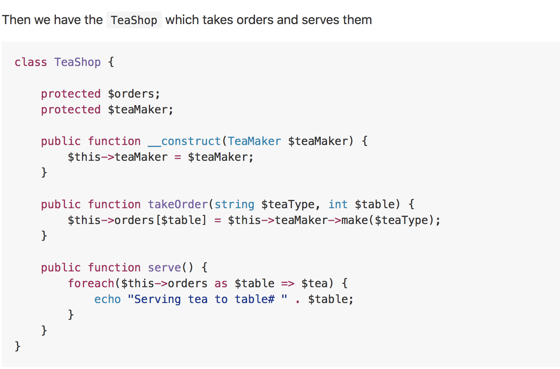
Example

Slide 53
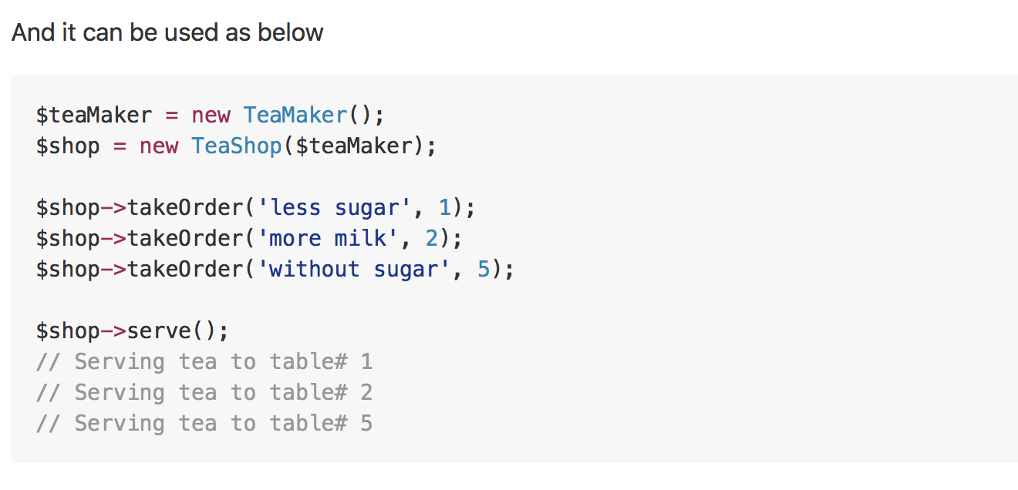
Example

Slide 54
Proxy
Real world example
Have you ever used an access card to go through a door? There are multiple options to open that door i.e. it can be opened either using access card or by pressing a button that bypasses the security. The door's main functionality is to open but there is a proxy added on top of it to add some functionality. Let me better explain it using the code example below.
In plain words
Using the proxy pattern, a class represents the functionality of another class.
Wikipedia says
A proxy, in its most general form, is a class functioning as an interface to something else. A proxy is a wrapper or agent object that is being called by the client to access the real serving object behind the scenes. Use of the proxy can simply be forwarding to the real object, or can provide additional logic. In the proxy extra functionality can be provided, for example caching when operations on the real object are resource intensive, or checking preconditions before operations on the real object are invoked.

Slide 55
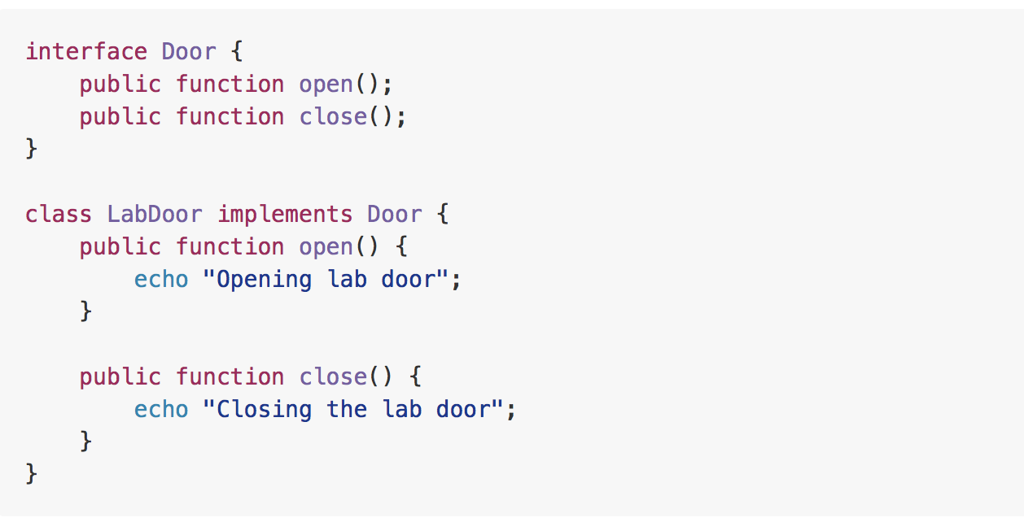
Example

Slide 56
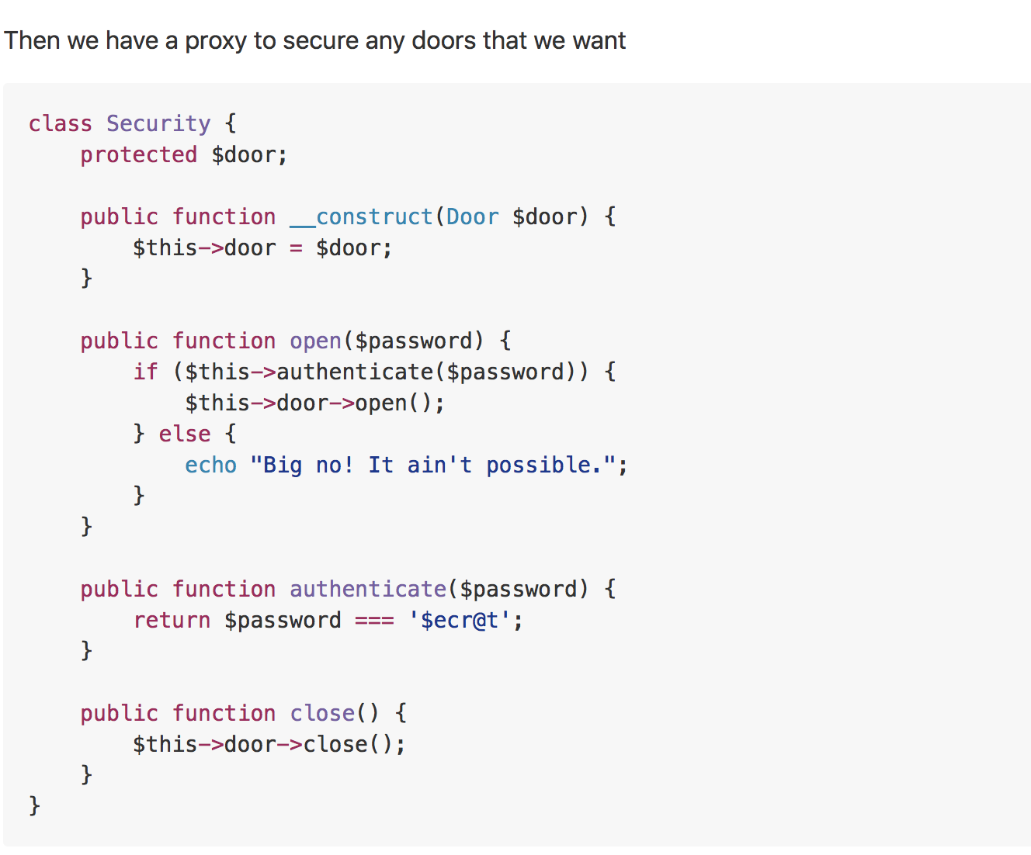
Example

Slide 57
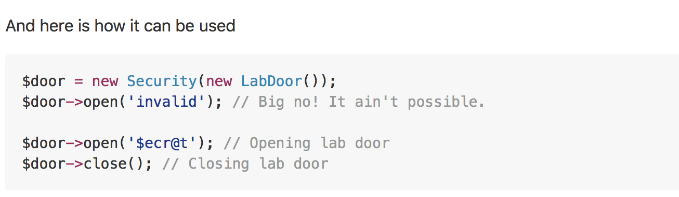
Example
Notes:
Yet another example would be some sort of data-mapper implementation. For example, I recently made an ODM (Object Data Mapper) for MongoDB using this pattern where I wrote a proxy around mongo classes while utilizing the magic method __call(). All the method calls were proxied to the original mongo class and result retrieved was returned as it is but in case of find or findOne data was mapped to the required class objects and the object was returned instead of Cursor.

Slide 58
Behavioral
In software engineering, behavioral design patterns are design patterns that identify common communication patterns between objects and realize these patterns. By doing so, these patterns increase flexibility in carrying out this communication.
Notes:
It is concerned with assignment of responsibilities between the objects. What makes them different from structural patterns is they don't just specify the structure but also outline the patterns for message passing/communication between them. Or in other words, they assist in answering "How to run a behavior in software component?"

Slide 59
Chain of Responsibility
Real world example
For example, you have three payment methods (A, B and C) setup in your account; each having a different amount in it. A has 100 USD, B has 300 USD and C having 1000 USD and the preference for payments is chosen as A then B then C. You try to purchase something that is worth 210 USD. Using Chain of Responsibility, first of all account A will be checked if it can make the purchase, if yes purchase will be made and the chain will be broken. If not, request will move forward to account B checking for amount if yes chain will be broken otherwise the request will keep forwarding till it finds the suitable handler. Here A, B and C are links of the chain and the whole phenomenon is Chain of Responsibility.
In plain words
It helps building a chain of objects. Request enters from one end and keeps going from object to object till it finds the suitable handler.
Wikipedia says
In object-oriented design, the chain-of-responsibility pattern is a design pattern consisting of a source of command objects and a series of processing objects. Each processing object contains logic that defines the types of command objects that it can handle; the rest are passed to the next processing object in the chain.

Slide 60
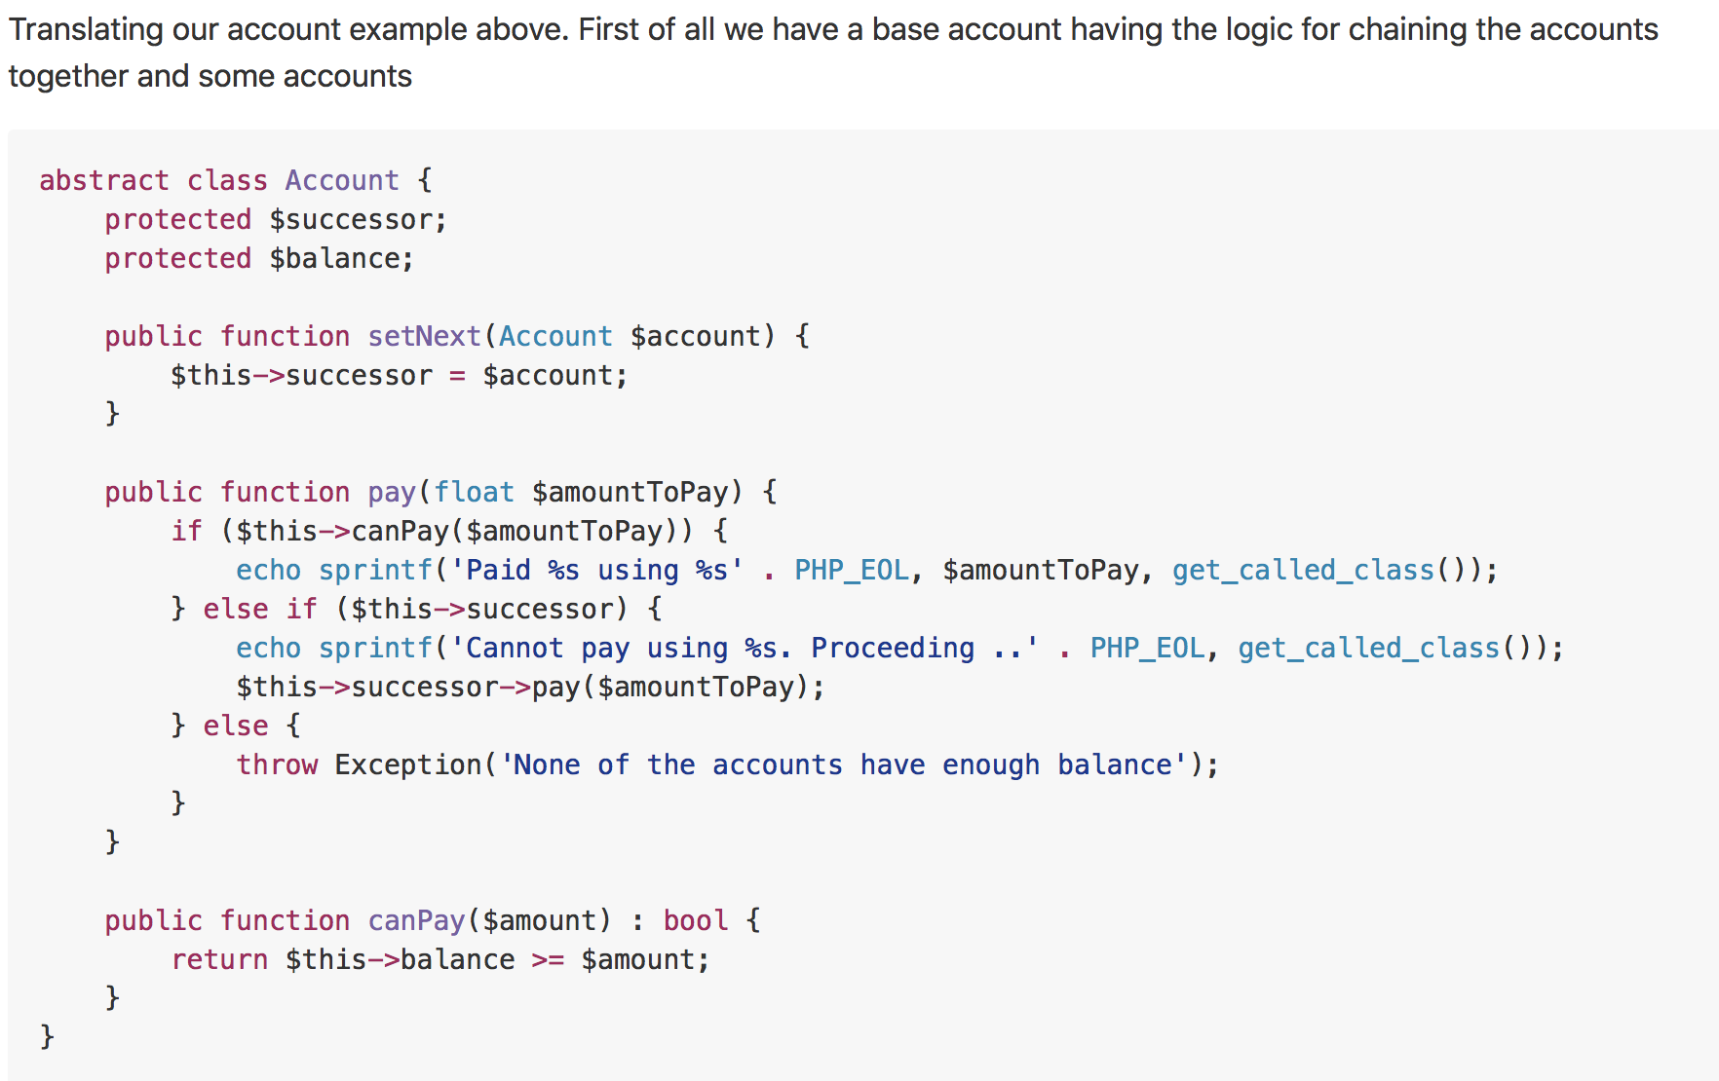
Example

Slide 61
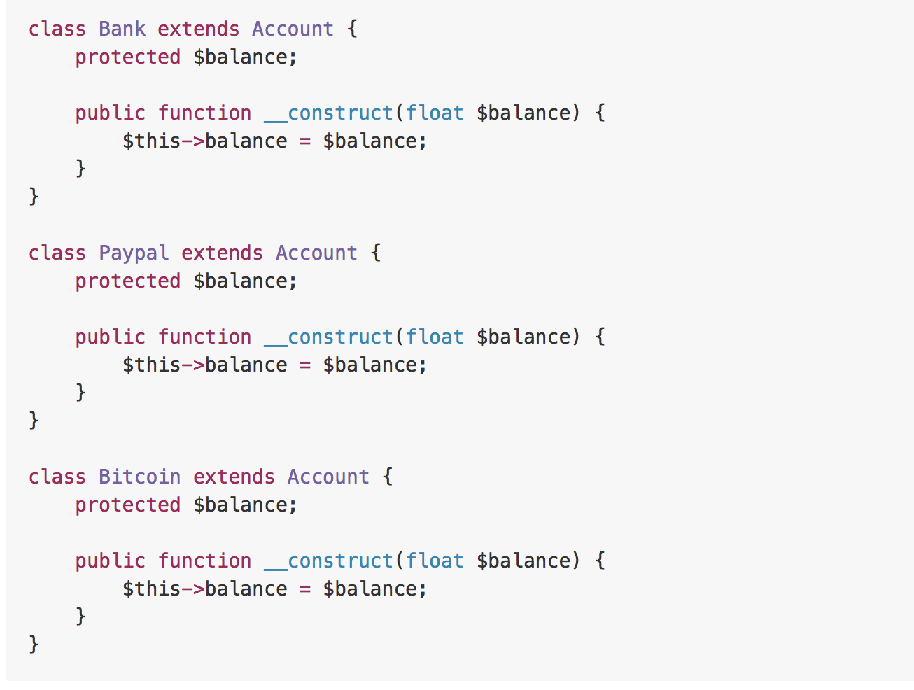
Example

Slide 62
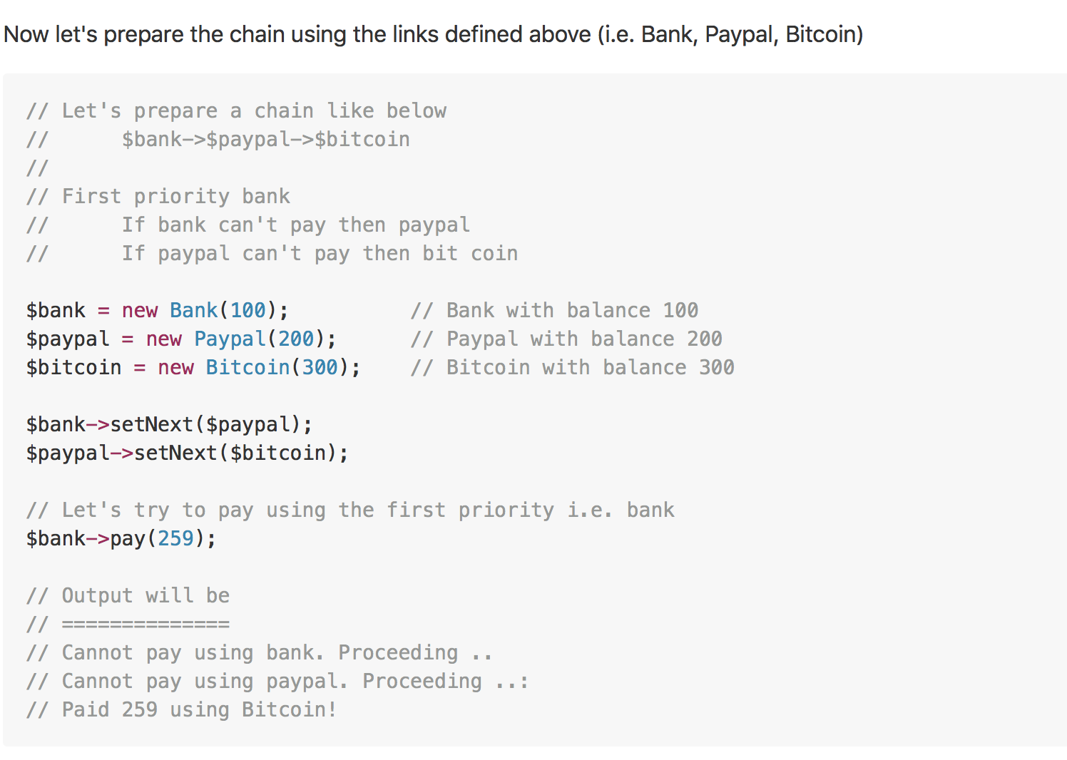
Example

Slide 63
Command
Real world example
A generic example would be you ordering a food at restaurant. You (i.e. Client) ask the waiter (i.e. Invoker) to bring some food (i.e. Command) and waiter simply forwards the request to Chef (i.e. Receiver) who has the knowledge of what and how to cook. Another example would be you (i.e. Client) switching on (i.e. Command) the television (i.e. Receiver) using a remote control (Invoker).
In plain words
Allows you to encapsulate actions in objects. The key idea behind this pattern is to provide the means to decouple client from receiver.
Wikipedia says
In object-oriented programming, the command pattern is a behavioral design pattern in which an object is used to encapsulate all information needed to perform an action or trigger an event at a later time. This information includes the method name, the object that owns the method and values for the method parameters.

Slide 64
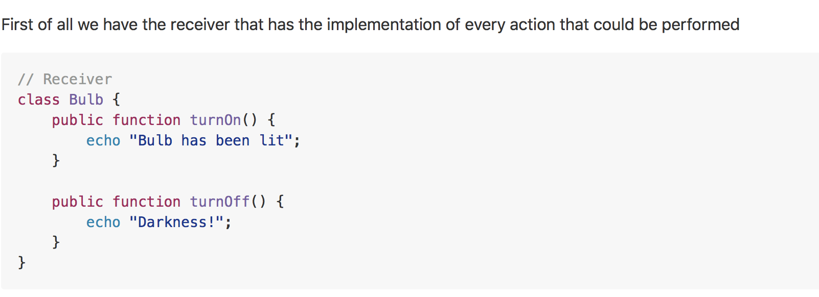
Example

Slide 65
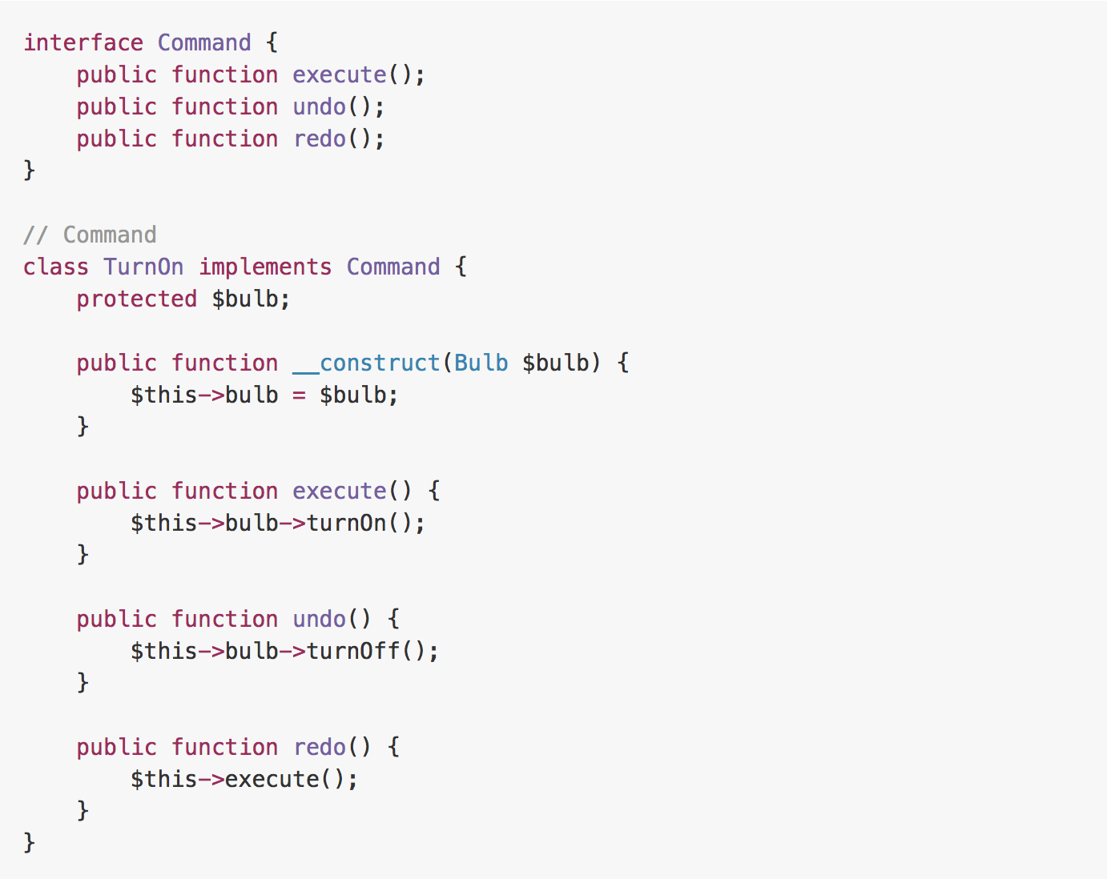
Example

Slide 66
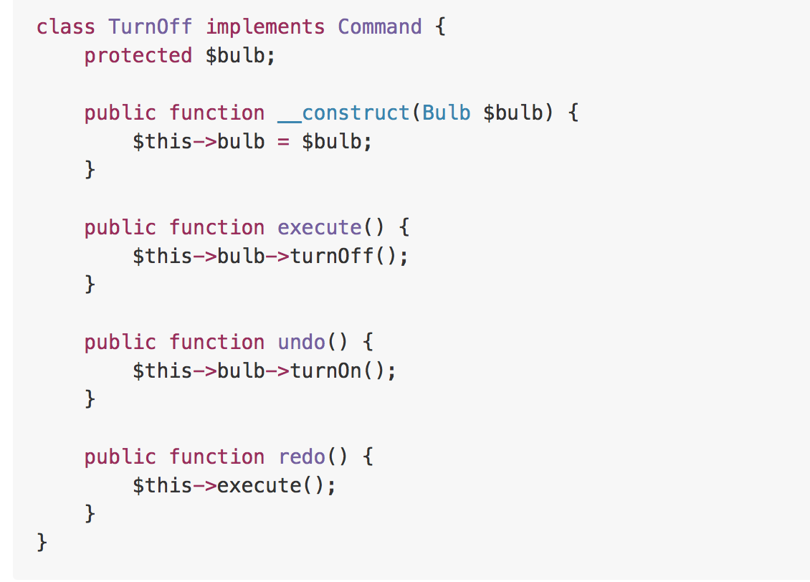
Example

Slide 67
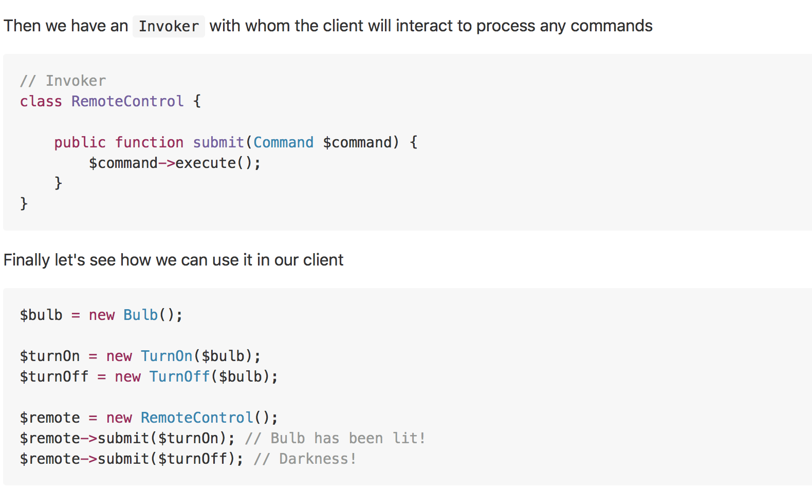
Example
Notes:
Command pattern can also be used to implement a transaction based system. Where you keep maintaining the history of commands as soon as you execute them. If the final command is successfully executed, all good otherwise just iterate through the history and keep executing the undo on all the executed commands.

Slide 68
Iterator
Real world example
An old radio set will be a good example of iterator, where user could start at some channel and then use next or previous buttons to go through the respective channels. Or take an example of MP3 player or a TV set where you could press the next and previous buttons to go through the consecutive channels or in other words they all provide an interface to iterate through the respective channels, songs or radio stations.
In plain words
It presents a way to access the elements of an object without exposing the underlying presentation.
Wikipedia says
In object-oriented programming, the iterator pattern is a design pattern in which an iterator is used to traverse a container and access the container's elements. The iterator pattern decouples algorithms from containers; in some cases, algorithms are necessarily container-specific and thus cannot be decoupled.

Slide 69
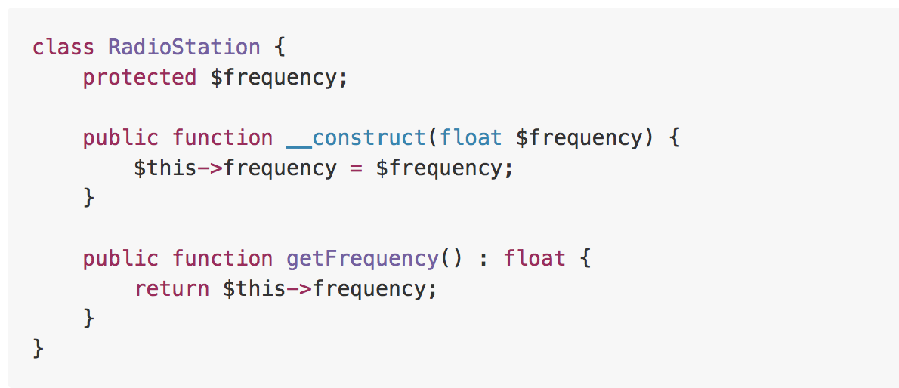
Example

Slide 70
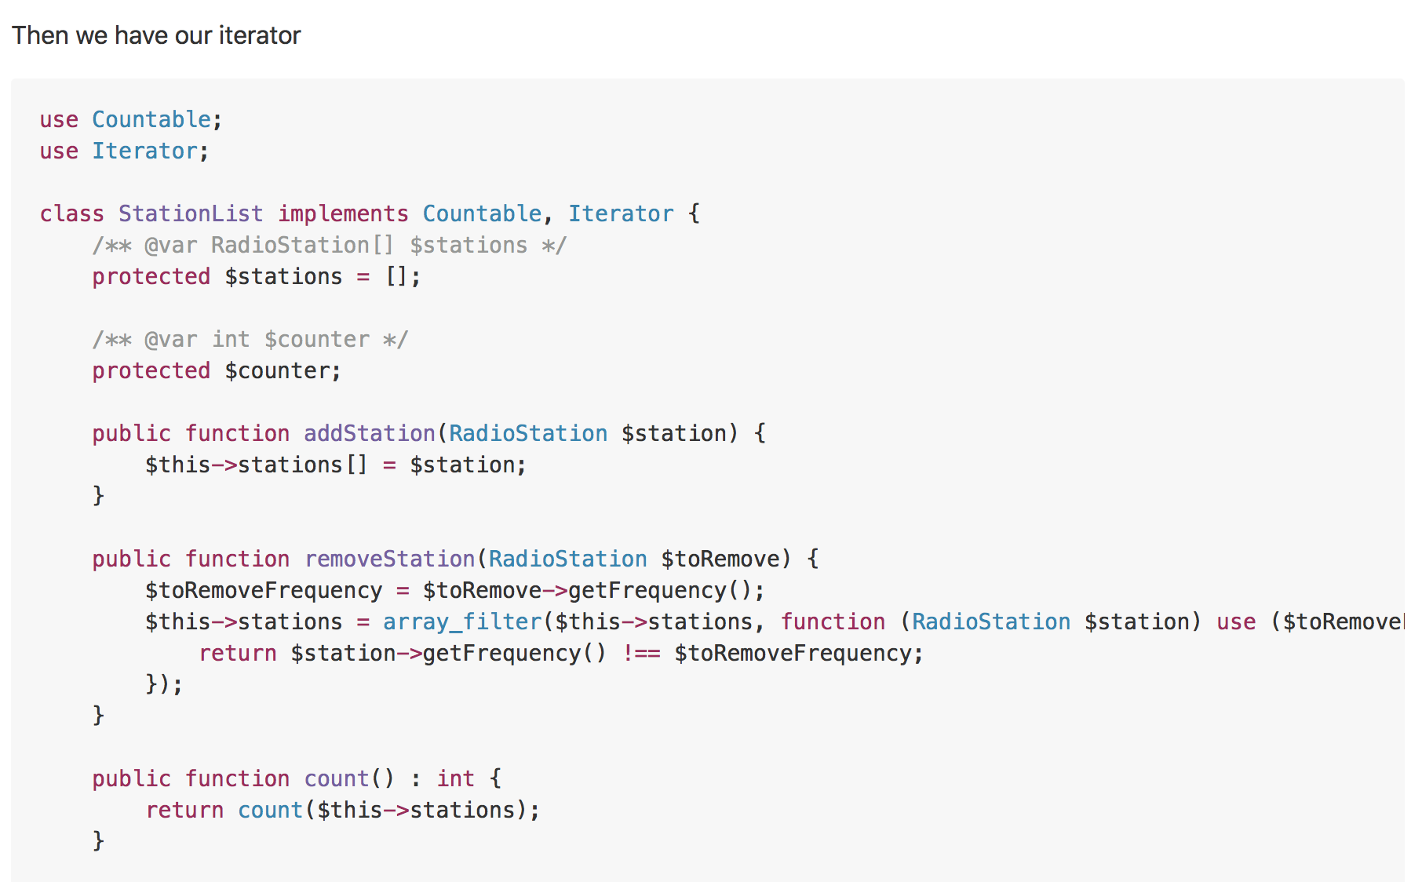
Example

Slide 71
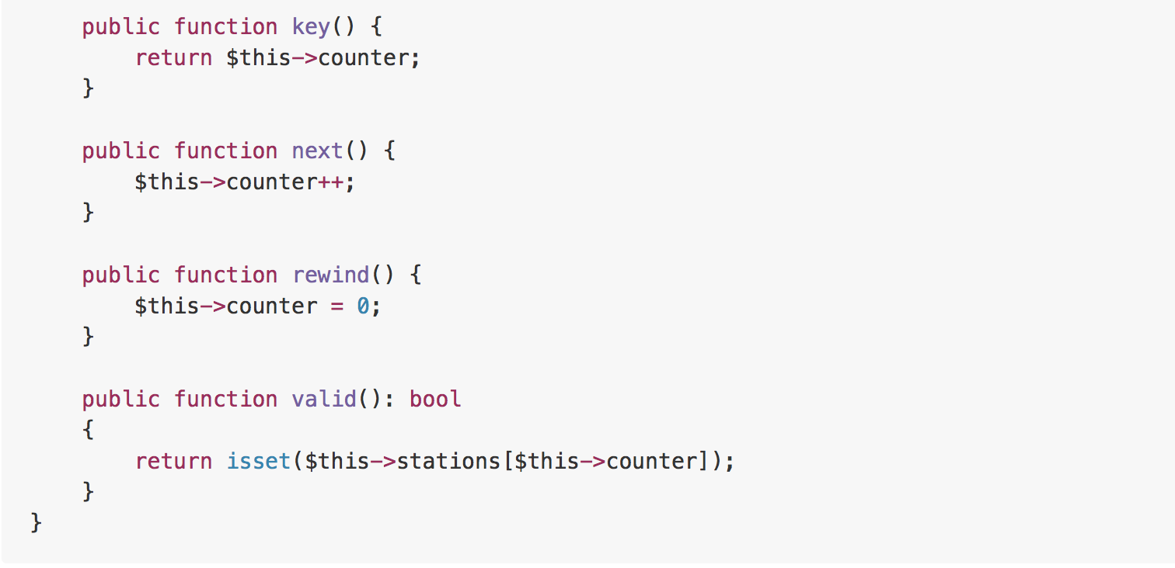
Example

Slide 72
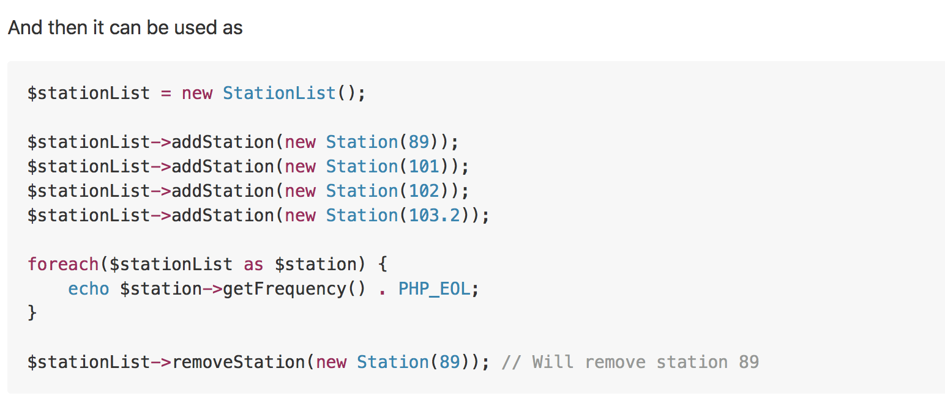
Example

Slide 73
Mediator
Real world example
A general example would be when you talk to someone on your mobile phone, there is a network provider sitting between you and them and your conversation goes through it instead of being directly sent. In this case network provider is mediator.
In plain words
Mediator pattern adds a third party object (called mediator) to control the interaction between two objects (called colleagues). It helps reduce the coupling between the classes communicating with each other. Because now they don't need to have the knowledge of each other's implementation.
Wikipedia says
In software engineering, the mediator pattern defines an object that encapsulates how a set of objects interact. This pattern is considered to be a behavioral pattern due to the way it can alter the program's running behavior.

Slide 74

Example

Slide 75

Example

Slide 76

Example

Slide 77
Memento
Real world example
Take the example of calculator (i.e. originator), where whenever you perform some calculation the last calculation is saved in memory (i.e. memento) so that you can get back to it and maybe get it restored using some action buttons (i.e. caretaker).
In plain words
Memento pattern is about capturing and storing the current state of an object in a manner that it can be restored later on in a smooth manner.
Wikipedia says
The memento pattern is a software design pattern that provides the ability to restore an object to its previous state (undo via rollback).
Notes:
Usually useful when you need to provide some sort of undo functionality.

Slide 78

Example

Slide 79

Example

Slide 80

Example

Slide 81
Observer
Real world example
A good example would be the job seekers where they subscribe to some job posting site and they are notified whenever there is a matching job opportunity.
In plain words
Defines a dependency between objects so that whenever an object changes its state, all its dependents are notified.
Wikipedia says
The observer pattern is a software design pattern in which an object, called the subject, maintains a list of its dependents, called observers, and notifies them automatically of any state changes, usually by calling one of their methods.

Slide 82

Example

Slide 83

Example

Slide 84

Example

Slide 85
Visitor
Real world example
Consider someone visiting Dubai. They just need a way (i.e. visa) to enter Dubai. After arrival, they can come and visit any place in Dubai on their own without having to ask for permission or to do some leg work in order to visit any place here; just let them know of a place and they can visit it. Visitor pattern lets you do just that, it helps you add places to visit so that they can visit as much as they can without having to do any legwork.
In plain words
Visitor pattern lets you add further operations to objects without having to modify them.
Wikipedia says
In object-oriented programming and software engineering, the visitor design pattern is a way of separating an algorithm from an object structure on which it operates. A practical result of this separation is the ability to add new operations to existing object structures without modifying those structures. It is one way to follow the open/closed principle.

Slide 86

Example

Slide 87

Example

Slide 88

Example

Slide 89

Example

Slide 90

Example

Slide 91

Example

Slide 92
Strategy
Real world example
Consider the example of sorting, we implemented bubble sort but the data started to grow and bubble sort started getting very slow. In order to tackle this we implemented Quick sort. But now although the quick sort algorithm was doing better for large datasets, it was very slow for smaller datasets. In order to handle this we implemented a strategy where for small datasets, bubble sort will be used and for larger, quick sort.
In plain words
Strategy pattern allows you to switch the algorithm or strategy based upon the situation.
Wikipedia says
In computer programming, the strategy pattern (also known as the policy pattern) is a behavioral software design pattern that enables an algorithm's behavior to be selected at runtime.

Slide 93

Example

Slide 94

Example

Slide 95

Example

Slide 96
State
Real world example
Imagine you are using some drawing application, you choose the paint brush to draw. Now the brush changes its behavior based on the selected color i.e. if you have chosen red color it will draw in red, if blue then it will be in blue etc.
In plain words
It lets you change the behavior of a class when the state changes.
Wikipedia says
The state pattern is a behavioral software design pattern that implements a state machine in an object-oriented way. With the state pattern, a state machine is implemented by implementing each individual state as a derived class of the state pattern interface, and implementing state transitions by invoking methods defined by the pattern's superclass. The state pattern can be interpreted as a strategy pattern which is able to switch the current strategy through invocations of methods defined in the pattern's interface.

Slide 97

Example

Slide 98

Example

Slide 99

Example

Slide 100
Template Method
Real world example
Suppose we are getting some house built. The steps for building might look like
Prepare the base of house
Build the walls
Add roof
Add other floors The order of these steps could never be changed i.e. you can't build the roof before building the walls etc but each of the steps could be modified for example walls can be made of wood or polyester or stone.
In plain words
Template method defines the skeleton of how a certain algorithm could be performed, but defers the implementation of those steps to the children classes.
Wikipedia says
In software engineering, the template method pattern is a behavioral design pattern that defines the program skeleton of an algorithm in an operation, deferring some steps to subclasses. It lets one redefine certain steps of an algorithm without changing the algorithm's structure.

Slide 101

Example

Slide 102

Example

Slide 103

Example

Slide 104


